Slide 1
Breakout: The Victim Triangle
Journey Together Conference 2025
September 4, 2025
Dr. Chip Dodd

Slide 2
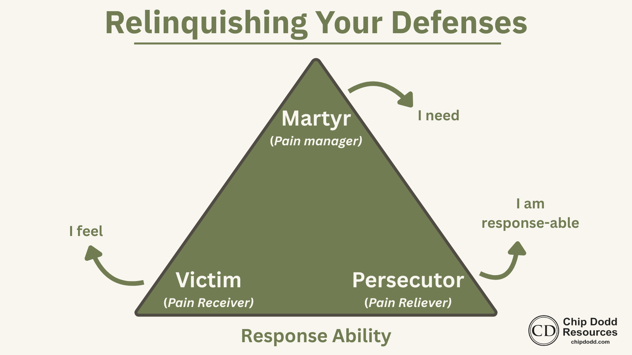

Slide 3
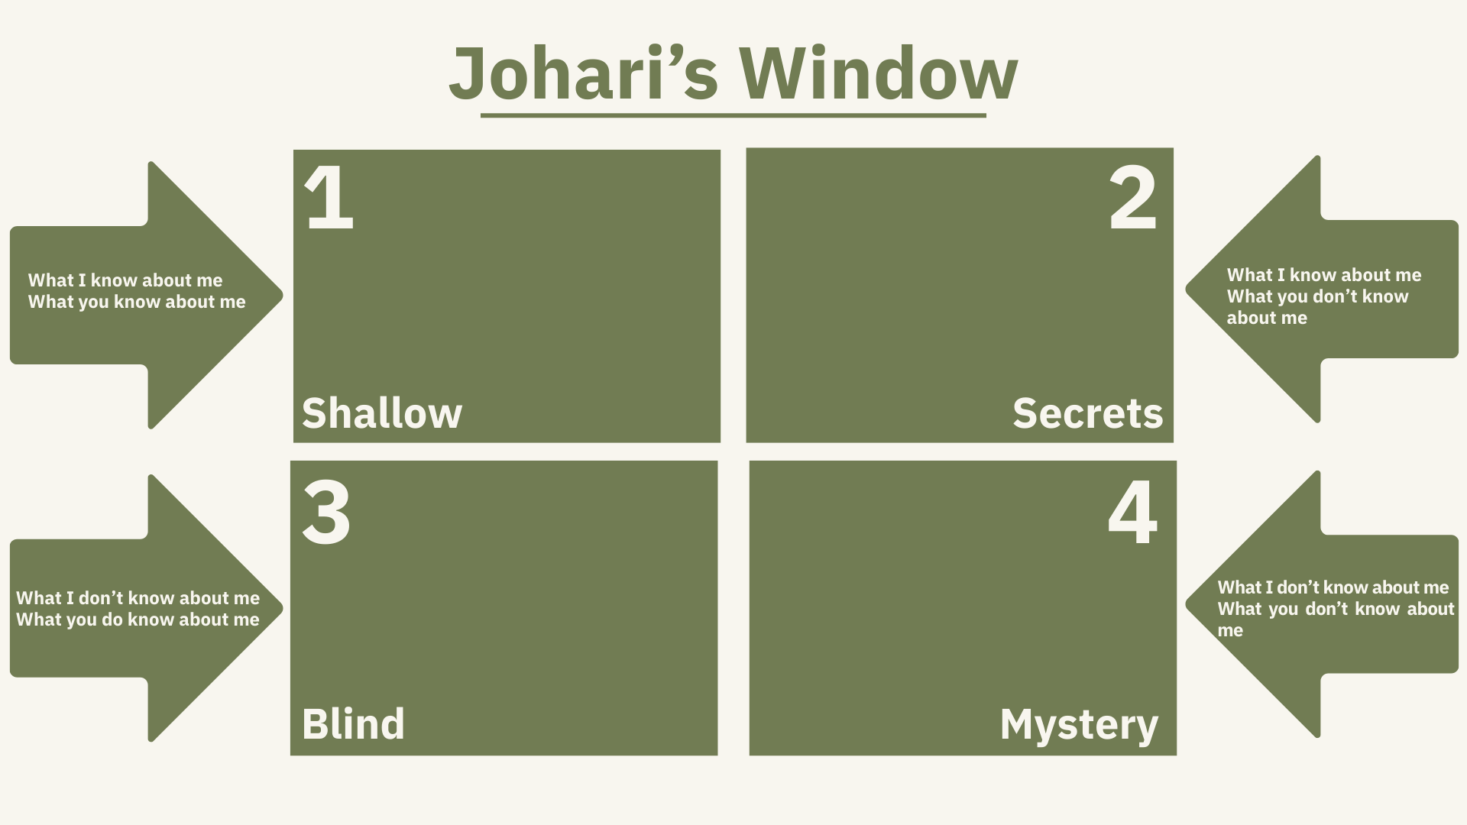

Slide 4

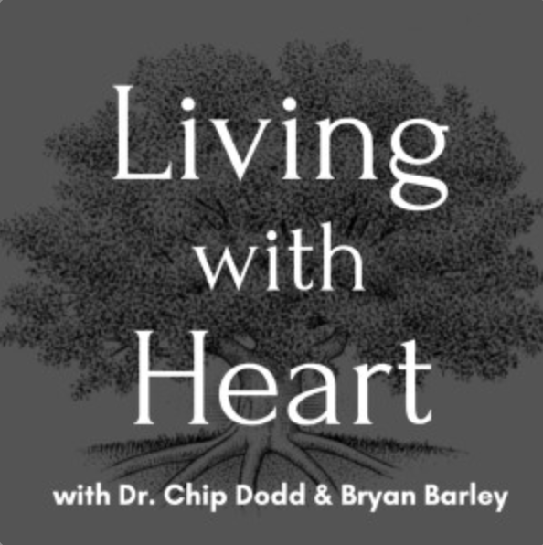

Resources
Living with Heart Podcast

Slide 5
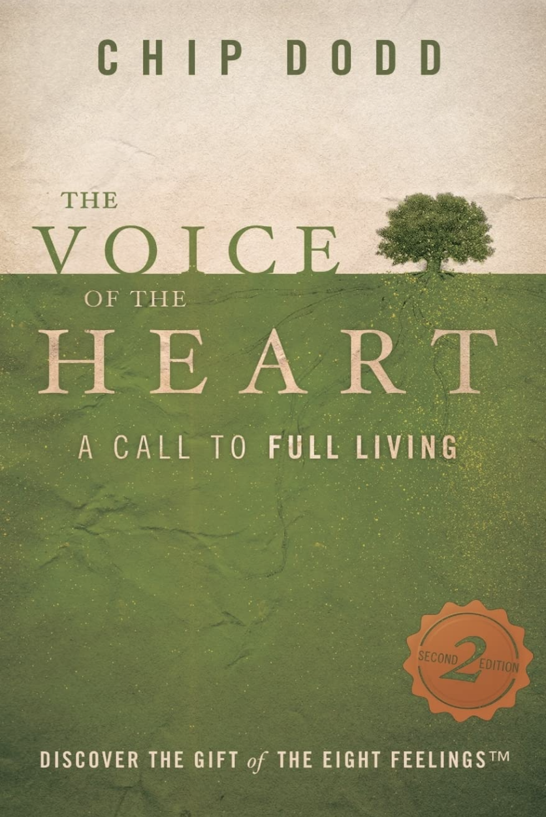
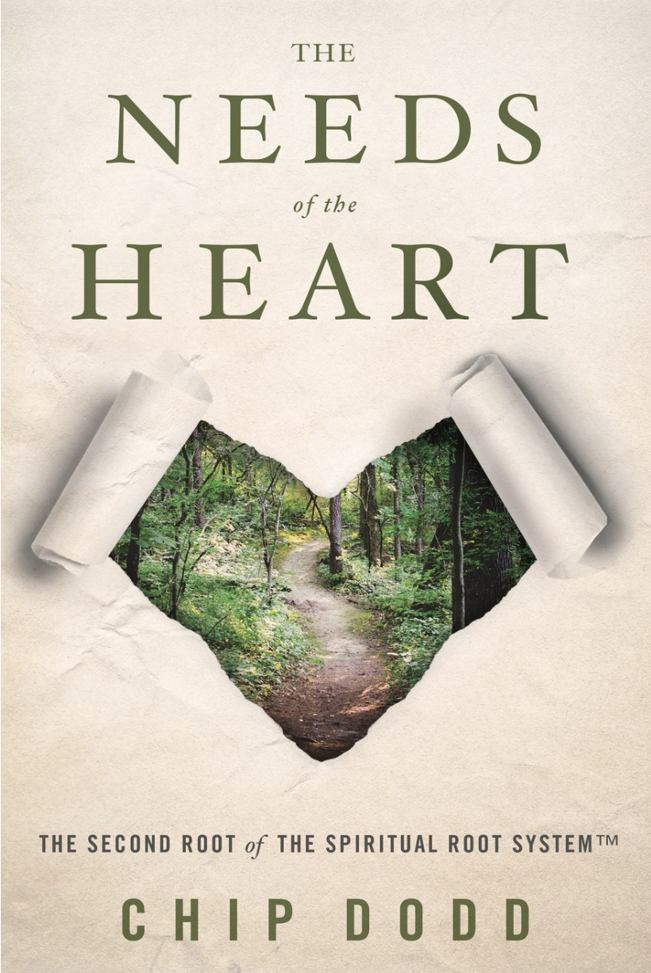
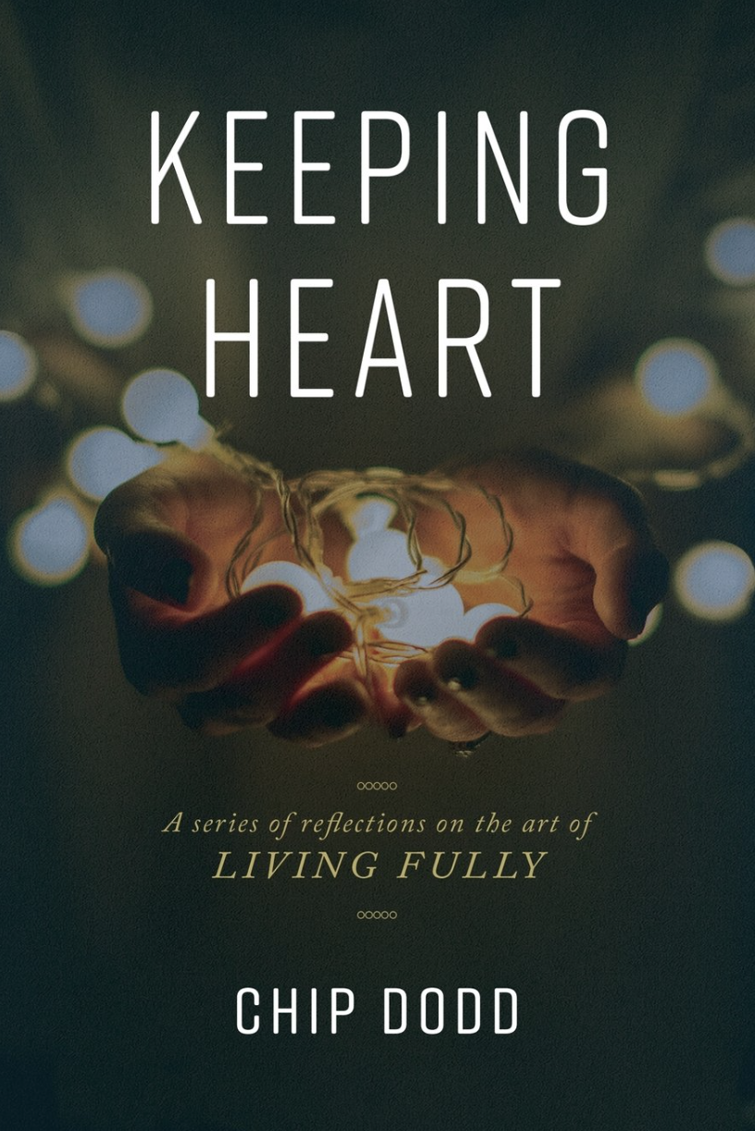
Books by Dr. Chip Dodd
“Discover the gift of the eight feelings.”

