Slide 1















The Collaborative Approach to Substance Use Recovery
Understanding the Benefit of Counseling and Occupational Therapy

Slide 2
01.
UNDERSTANDING SUBSTANCE USE AND LIFE SKILLS DECLINE
02.
THE IMPORTANCE OF LIFE SKILLS IN RECOVERY
03.
HOW SUBSTANCE USE IMPACTS LIFE SKILLS
04.
COLLABORATIVE ROLE OF COUNSELORS AND OTS
05.
HOW COUNSELORS AND OTS CAN COLLABORATE
06.
CASE STUDY
TABLE OF
CONTENTS
07.
CHALLENGES IN COLLABORATION

Slide 3
01. Understanding Substance Use and Life Skills Decline
What is SUD? How does it impact life skills?

Slide 4
Understanding Substance Use and Life Skills Decline
  What is Substance Use Disorder (SUD)?
    Substance Use Disorder is a chronic condition affecting cognitive, emotional, and social skills.
  Impact on Life Skills:
    Cognitive decline affecting concentration and memory
    Emotional difficulties impacting relationships
    Social consequences including isolation and impulsive behavior

Slide 5
02. The Importance of Life Skills in Recovery
What are life skills? How does it impact recovery?

Slide 6

The Importance of Life Skills in Recovery
  What are Life Skills?
    Communication, time management, self-care, budgeting, decision making skills.
  Life Skills and Recovery:
    Rebuilding independence and self-esteem
    Prepare for future employment or education opportunities

Slide 7
03. How Substance Use Impacts Life Skills
What is the cognitive impact? How about the social, emotional, and behavioral?

Slide 8

How Substance Use Impacts Life Skills
  Cognitive Decline:
    Difficulty concentrating, learning, and decision-making
  Emotional and Social Impact:
    Impulsivity, mood swings, and social isolation.
    Difficulty managing relationships and communicating effectively.
  Behavioral Consequences:
    Neglect of personal hygiene and disorganized living spaces.

Slide 9
04. Collaborative Role of Counselors and OTs
What are our distinct roles?

Slide 10

Collaborative Role of Counselors and OTs
  Role of Counselors:
    Provide emotional support and therapy
    Help develop relapse prevention plans
  Role of Occupational Therapists:
    Address functional deficits in daily activities
    Assist with building healthy routines and habits

Slide 11
05. How Counselors and OTs Can Collaborate
How can we make the best team?

Slide 12

How Counselors and OTs Can Collaborate
  Holistic Assessment:
    Counselor: Addresses emotional and physiological issues
    OT: Focuses on functional abilities and life skills
  Co-Developing Interventions
    Joint planning for addressing recovery and life skills
  Goal Setting and Joint Sessions:
    Set short and long term goals for both sobriety and functional independence

Slide 13

06. Case Study
Maria

Slide 14

Maria is a 29-year-old woman in early recovery from opioid use disorder, which began at
age 22 after a serious car accident left her with chronic back pain. Initially prescribed pain
medication, she transitioned to illicit opioids when her prescriptions ended. Over the years,
she experienced multiple short-term jobs, several evictions, and fractured family
relationships. Maria has been sober for four months after completing a 60-day residential
treatment program and now lives in a women’s sober living home with five other residents.
She attends one recovery meeting per week but has missed recent therapy sessions, saying
she “didn’t have it together.” Her days lack structure—she often sleeps until noon, spends
hours on her phone or watching TV, and forgets to take her antidepressants. Chronic pain
limits her activity, but she has not been consistent with recommended physical therapy
exercises. Maria’s living space is cluttered, her laundry piles up, and her hygiene is
inconsistent. She struggles with memory, focus, and becomes easily overwhelmed when
tasks require multiple steps. Socially, she avoids family gatherings due to shame and past
conflict, relying primarily on housemates for interaction. She reports frequent boredom,
loneliness, and mood swings, with occasional anxiety in public settings. Unemployed for two
years, Maria feels intimidated by job applications and interviews, depends on small stipends
from her parents, and often runs out of money before the month ends due to poor
budgeting. While she is motivated to maintain sobriety, she admits that she sometimes
wishes she could “just numb out” when life feels too overwhelming.

Slide 15
Maria’s Hidden Issues
01.
Daily Functioning and Routine
03.
Social and Emotional Health
Physical and Cognitive Health
Employment and Financial Stability
02.
04.

Slide 16
06. Case Study:
Role Breakdown
Addiction Couselor & OT

Slide 17

Role Breakdown for Maria
  Occupational Therapist (OT)
    Develop routines and habits
    Medication management strategies
    Household management strategies
    Adapt activities to manage pain
    Executive functioning strategies for focus and memory
    Job Readiness and financial planning
  Addiction Counselor
    Relapse prevention planning
    Trauma informed therapy to address shame
    CBT or DBT for emotional regulation
    Motivational interviewing for engagement
    Support for building sober networks

Slide 18
Role Breakdown for Maria Cont.
  Joint Collaboration
    Gradual exposure plan for public and social situations
    Role play job interviews with stress management strategies
    Integrate emotional coping skills into daily routines
    Co-create balanced weekly schedules with both therapy and functional activties

Slide 19
07. Challenges in Collaboration
Collaboration is not always easy.

Slide 20
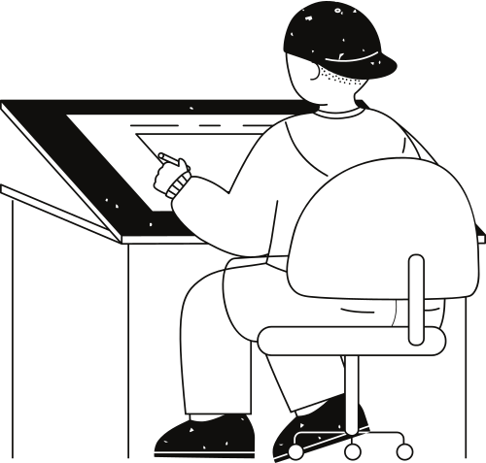
Challenges in Collaboration
  Differing Approaches:
    Counselors focus on emotional healing; OTs on functional tasks.
  Limited Resources:
    Not all centers have both counselors and OTs available.
  Client Resistance:
    Some clients may resist either therapy or OT interventions.

Slide 21
Conclusions
For SUD Counseling and OT

Slide 22
Recovery is a multifaceted process that includes life skills restoration.
Final Thoughts:
A holistic, collaborative approach improves recovery outcomes.
Recovery requires both personal growth and practical skills.

Slide 23
Thank you very much!
Any Questions?
Kathy@mindthegaptn.com
Cassidy@mindthegaptn.com

