Slide 1

Unveiling ADHD’s Complex Relationship with Substance Use and Young Adults
Trish Caldwell, MFT, LPC, CAADC, CCDP-D, CCTP
SVP, Clinical Operations
Promises Behavioral Health

Slide 2
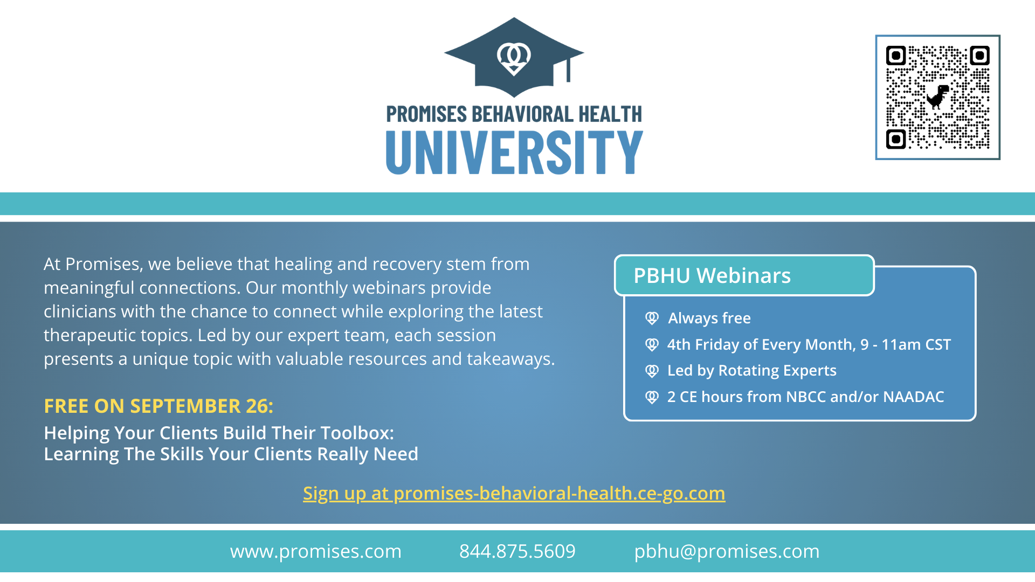

Slide 3


Slide 4
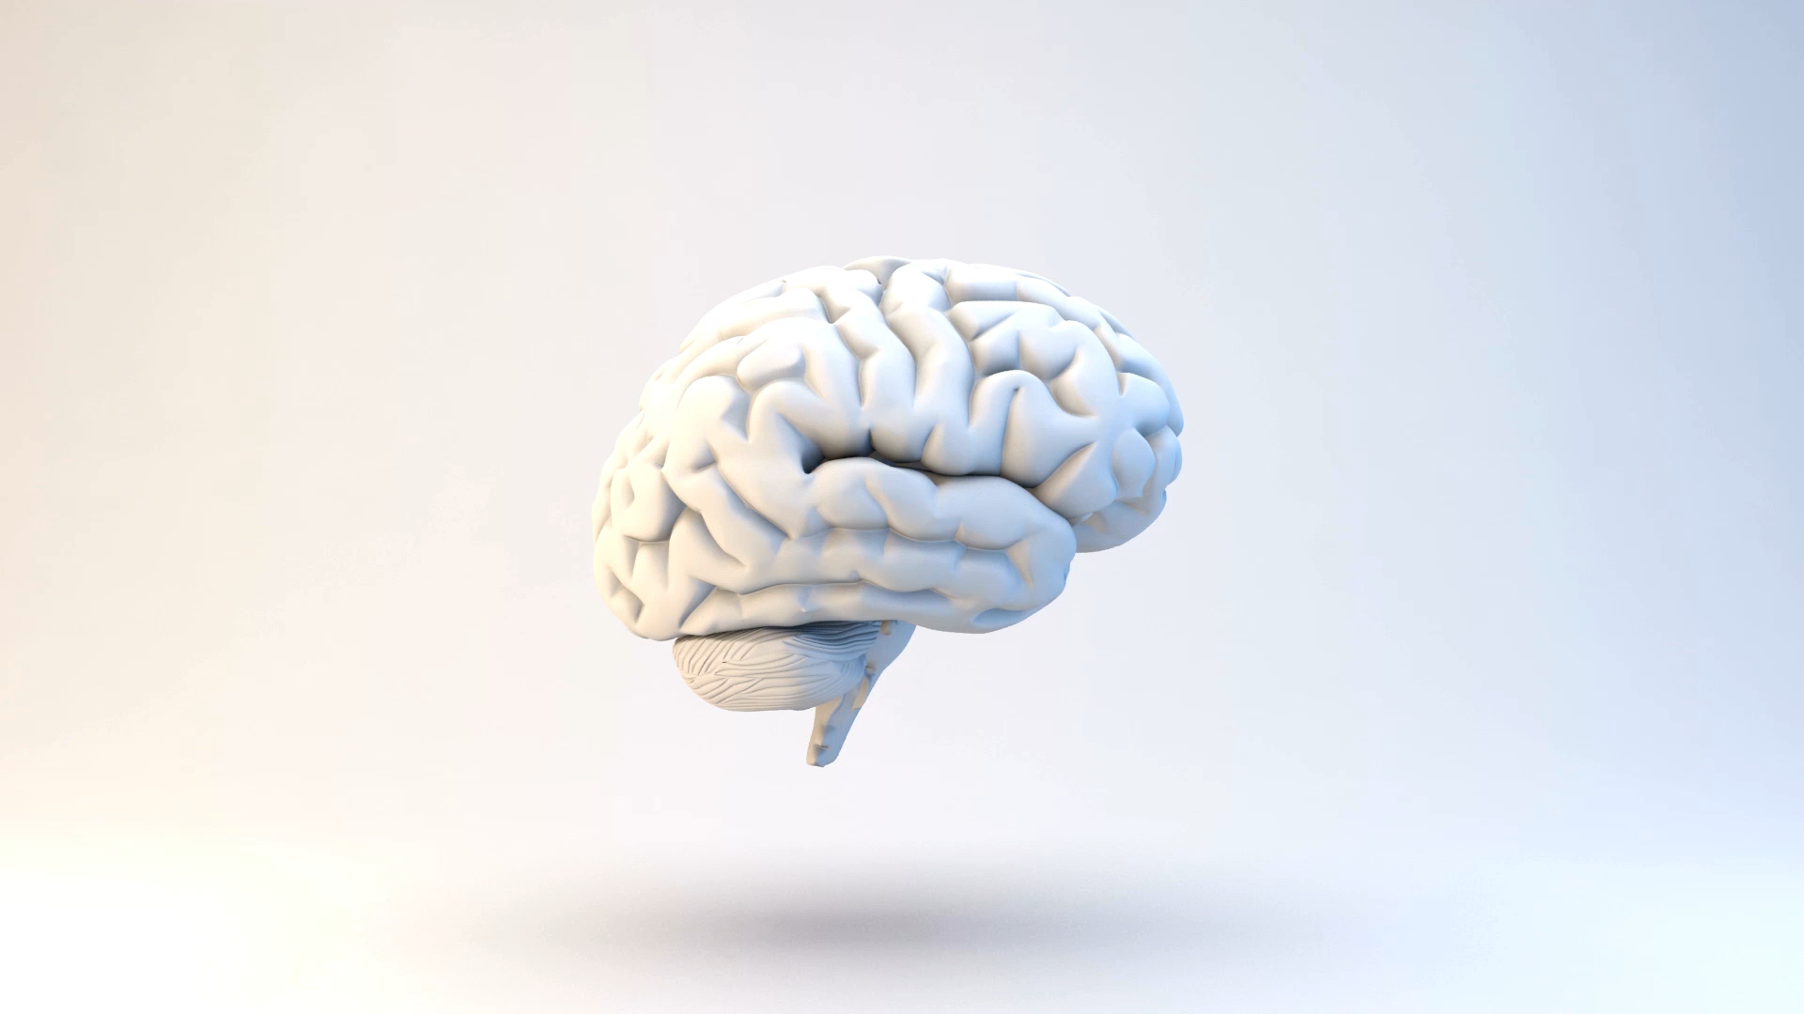
Objectives
Enhance Understanding of ADHD
Explore the Link Between ADHD and Substance Use Disorders
Provide Practical Strategies for Support and Intervention
Notes:
Educate participants on the nature of ADHD, its symptoms, and the factors contributing to its status as one of the most misunderstood and stigmatized disorders. Examine the interplay between ADHD symptoms, co-occurring mental health conditions, and the increased risk of substance use, with a focus on neurobiological, behavioral, and environmental factors. Equip participants with tools and approaches to reduce stigma, support individuals with ADHD effectively, and address the challenges posed by co-occurring substance use disorders

Slide 5
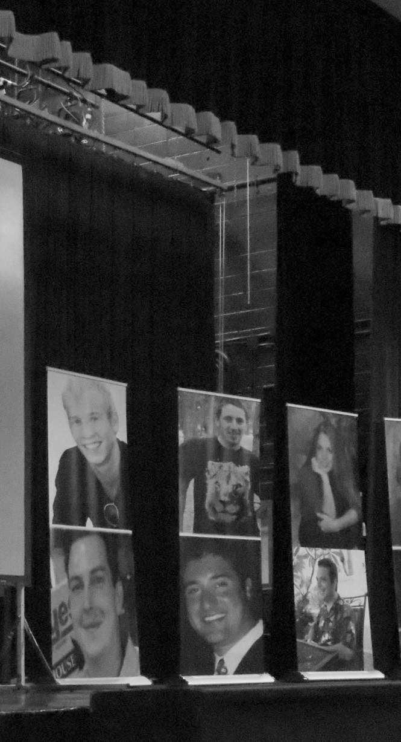
NOPE
“I saw that there are a lot of people in the adult ADHD population dying because of drug overdose”
Studies estimated about one in four patients who experience substance use disorder have been diagnosed with ADHD.

Slide 6
Common Myths and Facts about ADHD
1. Myth: ADHD is not a real condition.
Fact: ADHD (Attention Deficit Hyperactivity Disorder) is a well-documented neurodevelopmental disorder recognized by major medical organizations, including the American Psychiatric Association and World Health Organization. It has a strong genetic component and is linked to differences in brain structure and function, particularly in areas governing attention and impulse control.
2. Myth: ADHD only affects children.
Fact: While ADHD symptoms are often identified in childhood, it can persist into adulthood. Research shows that 60-70% of children with ADHD continue to experience symptoms as adults, such as difficulty with organization, focus, and impulse control.
3. Myth: People with ADHD are just lazy or undisciplined.
Fact: ADHD is not about laziness. People with ADHD struggle with executive functioning, which impacts their ability to plan, prioritize, and follow through on tasks. This is due to differences in brain processes, not a lack of effort or intelligence.
4. Myth: ADHD is caused by bad parenting or too much sugar.
Fact: ADHD is not caused by parenting styles or diet. Although nutrition and routines can influence symptoms, ADHD primarily stems from genetics and neurological differences. Environmental factors, like prenatal exposure to toxins, can also contribute.
Source: https://www.moneralo.com/how-to-deal-with-adhd-in-teenage-children/
Notes:
An estimated 7 million (11.4%) U.S. children aged 3–17 years have ever been diagnosed with ADHD, according to a national survey of parents using data from 2022.

Slide 7
Common Myths and Facts about ADHD
5. Myth: ADHD only involves hyperactivity.
Fact: ADHD has three subtypes: inattentive, hyperactive/impulsive, and combined. Not everyone with ADHD is hyperactive; many struggle primarily with focus, organization, and forgetfulness.
6. Myth: Medication is the only treatment for ADHD.
Fact: While medications like stimulants are effective for many, ADHD treatment often involves a combination of therapies, including behavioral therapy, coaching, mindfulness, and lifestyle adjustments.
7. Myth: People with ADHD can’t focus on anything.
Fact: Individuals with ADHD often experience hyperfocus on activities they find interesting. The issue lies in regulating attention, not the inability to pay attention at all.
8. Myth: ADHD is overdiagnosed.
Fact: ADHD is sometimes misunderstood or misdiagnosed, but it is also frequently underdiagnosed, especially in women, minorities, and adults who may present with less obvious symptoms.
Notes:
“You just need to try harder.”This neurological condition affects the brain's ability to regulate attention and impulse control. Telling someone with ADHD to try harder can make them feel inadequate and frustrated, exacerbating symptoms they're trying to manage.

Slide 8

Fast facts
Males are almost three times more likely to be diagnosed with ADHD than females. Just 4.2 percent of women will be diagnosed..
An estimated 7 million (11.4%) U.S. children aged 3–17 years have been diagnosed with ADHD, according to a national survey of parents using data from 2022.
The average age of ADHD diagnosis is 7 years old.
Symptoms of ADHD typically first appear between the ages of 3-6 years old
ADHD isn’t just a childhood disorder.
ADHD is five to 10 times more common among adult with alcohol use disorder than it is in people without the condition.
Approximately 25% of adults who go to a treatment center for alcohol and substance abuse also live with ADHD
Approximately 6.0% of U.S. adults currently have a diagnosis of ADHD, which translates to around 15.5 million people.
Source: https://www.healthline.com/health/adhd/facts-statistics-infographic#fast-facts
http://dx.doi.org/10.15585/mmwr.mm7340a1
Notes:
Citation: Staley BS, Robinson LR, Claussen AH, et al. Attention-Deficit/Hyperactivity Disorder Diagnosis, Treatment, and Telehealth Use in Adults — National Center for Health Statistics Rapid Surveys System, United States, October–November 2023. MMWR Morb Mortal Wkly Rep 2024;73:890–895. DOI: http://dx.doi.org/10.15585/mmwr.mm7340a1.

Slide 9
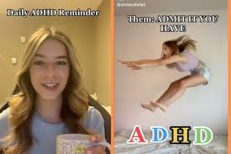
Is TikTok or Covid Increasing the Number of Self-Diagnoses of ADHD in Young People?
Spike in prescriptions for Adults with ADHD (not diagnoses)
Increase in social media usage during the pandemic resulted in people self-diagnosing ADHD after viewing TikTok videos.
Improve mental health stigma?
Most on TikTok are not experts in ADHD and could have led to overdiagnosis (1).
Approximately half of the analyzed TikTok videos about ADHD were misleading.
Clinicians should be aware of the widespread dissemination of health misinformation on social media platforms and its potential impact on clinical care (2).
Image source: https://www.upworthy.com/college-student-adhd-tiktok
Notes:
Furthermore, the impact on already stretched waiting lists should be considered, with individuals who’s perceived ADHD traits are not impacting on their quality of life

Slide 10
Gender Differences
Boys tend to display externalized symptoms that most people think of when they think of ADHD behavior, for example:
    impulsivity or “acting out”
    hyperactivity, such as running and jumping
    lack of focus, including inattentiveness
ADHD in Girls is often easy to overlook because it’s not “typical” ADHD behavior. The symptoms aren’t as obvious as they are in boys. They can include:
    being withdrawn
    low self-esteem and anxiety
    impairment in attention that may lead to difficulty with academic achievement
    inattentiveness or a tendency to “daydream”
    verbal aggression, such as teasing, taunting, or name-calling
    “Promiscuity”
Girls with ADHD have an increased risk of sexual assault or teenage pregnancy

Slide 11
Complications
Approximately 50% of adults with untreated ADHD will develop a Substance use Disorder at some point
33% never finish high school
46% of untreated boys will be arrested for a felony by age 16 (compared to 11% general population) and 21% of adults (compared to 1%)
30-40% of children with Attention Deficit Hyperactivity Disorder have affective disorders such as depression and anxiety
75% have interpersonal problems (depression/ anxiety/ family)
21-25% of inmates in a number of studies have been found to have ADHD (1)
40% more likely higher rates of divorce , domestic violence, and early marriages
8X higher percentage of accidents, speeding tickets, and revoked or suspended licenses

Slide 12
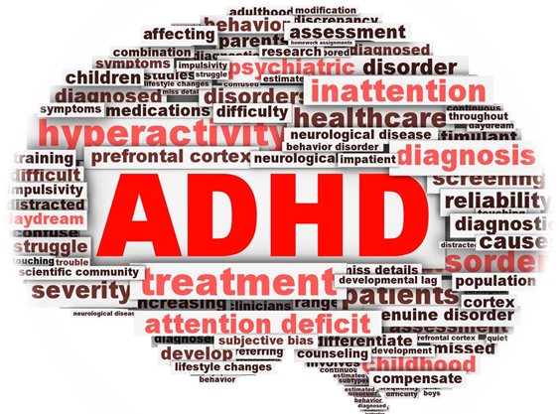
The Truth about ADHD
It is a chronic neurodevelopmental disorder that affects the development and function of the brain.
Less than half of those with it are being treated
One of the most common childhood disorders yet greatest risks
Many with it are NOT hyperactive- and have the inattentive type (poor school performance- “lazy”)
It’s been clinically researched for over 40 years
Treatment can be very effective

Slide 13

ADHD: An overview
“It's the perfect representation of the beauty and the chaos associated with having ADHD”

Slide 14

The Reality
“Jumping into the fire without thinking”- regret
Poor executive decision-making skills
Interpersonal difficulties with friends and family
Prevalence for our “Heroes”- and high-risk professions
Success is best when highly stimulated: Michael Phelps

Slide 15
ADHD According to the DSM-V
A persistent pattern of inattention and/or hyperactivity-impulsivity that interferes with functioning or development, as characterized by (1) and/or (2):
(1) Inattention: Six (or more) of the following symptoms have persisted for at least 6 months to a degree that is inconsistent with developmental level and that negatively impacts directly on social and academic/occupational activities:
  Often fails to give close attention to details or makes careless mistakes in schoolwork, at work, or during other activities
  Often has difficulty sustaining attention in tasks or play activities
  Often does not seem to listen when spoken to directly

Slide 16
ADHD According to the DSM-V
(2) Hyperactivity and impulsivity: Six (or more) of the following symptoms have persisted for at least 6 months to a degree that is inconsistent with developmental level and that negatively impacts directly on social and academic/occupational activities:
  • Often fidgets with or taps hands or feet or squirms in seat
  • Often leaves seat in situations when remaining seated is expected
  • Often runs about or climbs in situations where it is inappropriate
  • Often unable to play or take part in leisure activities quietly
  • Is often “on the go” acting as if “driven by a motor”

Slide 17
ADHD According to the DSM-V
Often does not follow through on instructions and fails to finish schoolwork, chores, or duties in the workplace
Often has difficulty organizing tasks and activities
Often avoids, dislikes, or is reluctant to engage in tasks that require sustained mental effort
Often loses things necessary for tasks or activities
Is often easily distracted by extraneous stimuli
Is often forgetful in daily activities

Slide 18
ADHD According to the DSM-V
Often talks excessively
Often blurts out an answer before a question has been completed
Often has trouble waiting his/her turn
Often interrupts or intrudes on others
Present before age 12 years
Present in two or more settings
Interfere with, or reduce the quality of, social, school, or work functioning

Slide 19

Does this sound Familiar?
Inattentive:
Does your attention wander easily? Hey Look a Squirrel!
Do you have difficult completing tasks? I keep forgetting to finish the project
Do you have difficulty paying attention to details? I thought I ordered a large but oh well I will figure it out
Are you easily distracted by new things? Look how shiny that is!
Do you have a habit of losing things? I keep losing my keys and wallet
Are too many tasks too much? Please go upstairs to brush your teeth, put your sneakers on and grab your backpack…20 minutes later

Slide 20
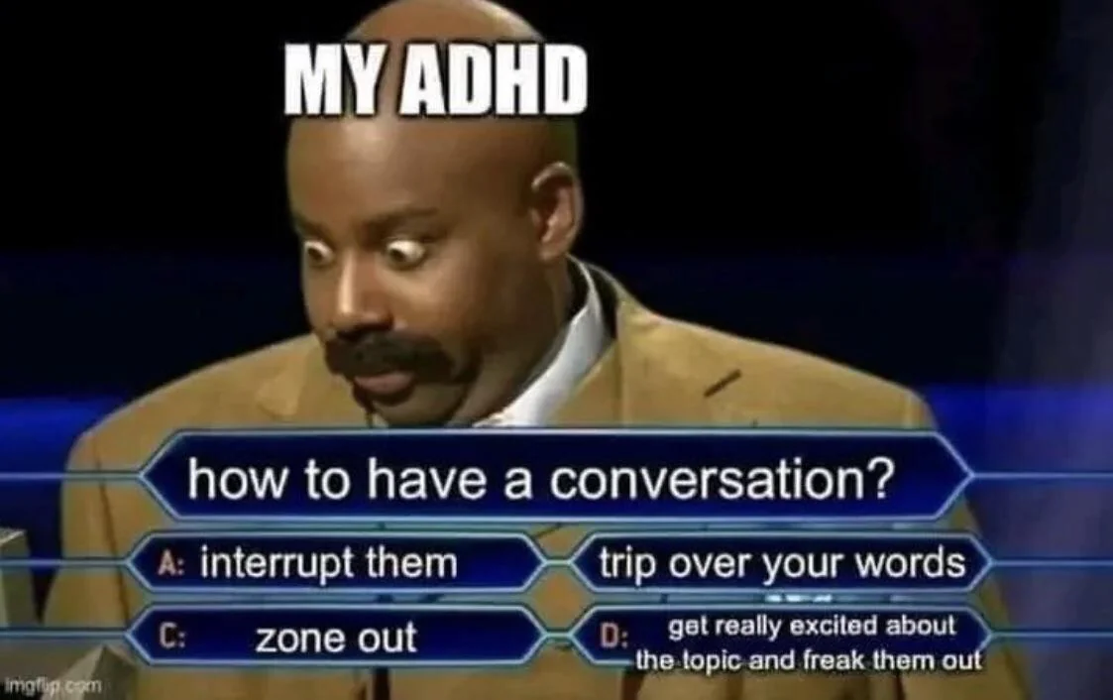
Does this sound Familiar?
Hyperactive:
Are you restless and always needing to move around? While sitting at the dr office lets play a game
Do you have a hard time staying up with conversation because you are thinking of other things? Wait what are you saying?? I wonder why cats are so funny?
Are you inpatient? Why is this line SOO long!!!
Are you forgetful? What did you ask me again to bring?

Slide 21
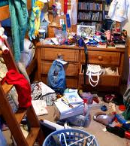
Does this sound Familiar?
Impulse Control:
Do you struggle with time management? I can go to the movies, the bank and will be there on time (arrives over an hour late)
Are you impulsive? I’ll do it!!!
Are you reactive emotionally? I am not sure why I acted that way…
Do you take risks? I want to swim with sharks jump out of airplanes…
Do you struggle with organization? I keep forgetting to pack my toothbrush
Do you struggle with rule governed behaviors? Stop signs are “stoptional”
Are you messy? My room is a wreck
Runs risk of Substance use

Slide 22

https://www.youtube.com/watch?v=4uJv3y9ajQY

Slide 23
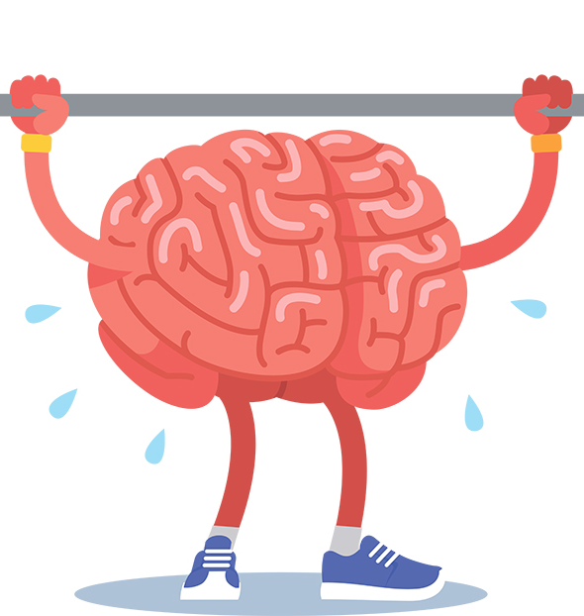
“ADHD Truly is a Superpower”
Intelligent
Creative
Athletic
Think outside the box
Spontaneous
Fun!
Adventurous
Successful
CEOs, Heroes, artists, athletes, musicians
Vitalii Petrenko/Shutterstock.com

Slide 24
Core issues with ADHD and SUD
Impulsivity
Poorly regulated activity—hyperactivity
Distractibility—poor sustained attention
Disorganization
Diminished rule governed behavior
Emotional over arousal
Poor/No generalization of information
Variability of task performance

Slide 25
Implications in Treatment of ADHD and SUD
Task Initiation
Organization
Self regulation
Planning
Time management
Goal directed persistence- keeping track of progress to sustain motivational interest
flexibility

Slide 26
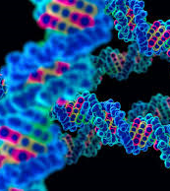
Etiology of ADHD
Genetics
  Researchers at the National Institutes of Health have successfully identified differences in gene activity in the brains of people with attention deficit hyperactivity disorder (ADHD)
Oxygen deprivation
Brain trauma
Food allergies
Lead exposure
Infections
Notes:
https://www.nih.gov/news-events/news-releases/nih-researchers-unlock-pattern-gene-activity-adhd. To date, this is the first study to use postmortem human brain tissue to investigate ADHD. Other approaches to studying mental health conditions include non-invasively scanning the brain, which allows researchers to examine the structure and activation of brain areas. However, these studies lack information at the level of genes and how they might influence cell function and give rise to symptoms.

Slide 27
ADHD and Inheritance
Inherited 57-97% (mean 80%)
If parent has ADHD—offspring risk 20-54%
25-30% of fathers
15-20% of mothers
Identical twins 55-92%
Child with ADHD
male sibling 35%
female sibling 15%

Slide 28
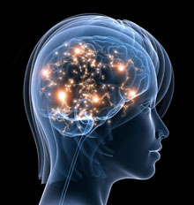
The Brain

Slide 29
Brain Development of a Young Adult
Adolescence is a period of significant brain change.
The developmental period extends into the mid-20s
During adolescence ‘pruning’ occurs, leaving a brain that is faster and more efficient.
There is differential effectiveness of various regions in the brain until the ‘pruning’ is complete

Slide 30
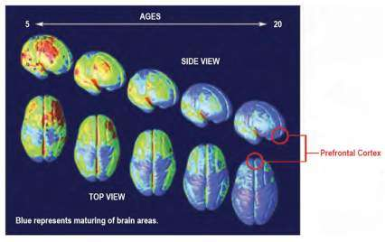
The Developing Brain
The image depicts top and side views of the developing brain.
The prefrontal cortex is the last area of the brain to mature.
The brain continues to develop through early adulthood.
Mature brain regions at each developmental stage are indicated in blue.
The prefrontal cortex (red circles), which governs judgment and self-control, is the last part of the brain to mature.
Source: PNAS 101:8174–8179, 2004.

Slide 31
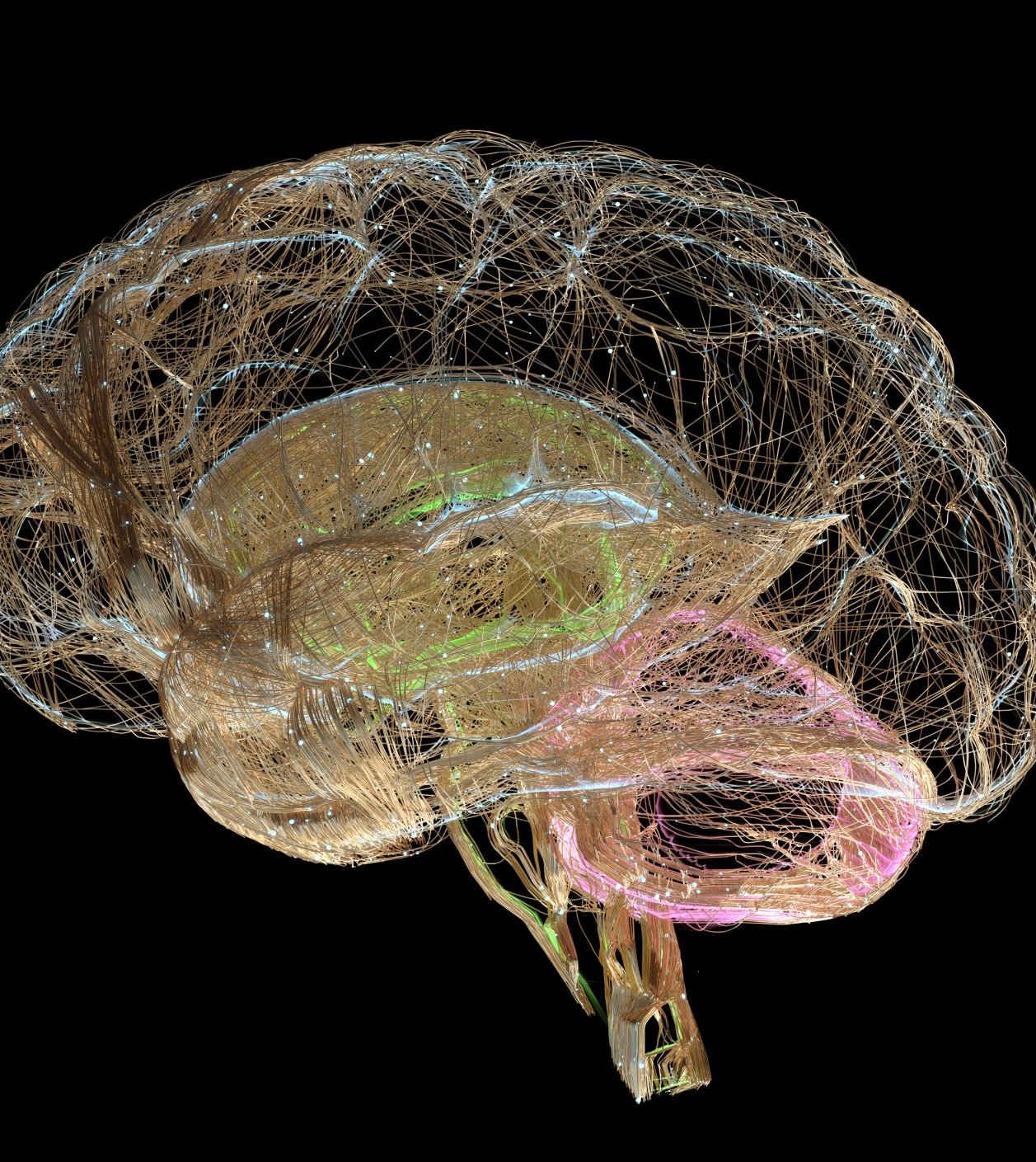
Brain Development
Brain plasticity and critical period for learning emotion regulation – implications for window of optimal intervention (Dahl, 2004)
Vulnerability as opportunity
Risk taking, intensity, arousal/sensation seeking and emotional vulnerability as normative with context as a mediating valuable toward dysfunction
Not everyone is at the same place on the continuum of risk and thrill seeking
Notes:
cortical grey matter volume declines childhood throughout adolescence; the grey matter volume of the mid-dorsolateral frontal prefrontal cortex (DLPFC), peaks in mid-adolescence, declines and then stabilizes in early adulthood
regions subserving higher-order cognitive functioning develop and mature later than “primary” function regions
the development of subcortical regions is also pronounced during adolescence,
decreases in grey matter during adolescence have often been interpreted as pruning of redundant synapses
regions subserving higher-order cognitive functioning develop and mature later than “primary” function regions
Behaviourally, nonhuman adolescents tend to exhibit increased novelty seeking, peer interactions and consummatory and hedonic behaviours.² Similarly, human adolescents make risky choices and exhibit greater emotional reactivity than either children or adults
A primary cognitive feature defining the progression throughout adolescence is the ability to control impulses and delay gratification in favour of goal-directed and more optimized outcomes and behaviours.^{3,4} Accumulating data indicates that adolescent behaviour is differentially biased in motivationally charged contexts compared with adult behaviour; correspondingly, sensitivity to rewards peaks during adolescence

Slide 32

ADHD and the Brain

Slide 33
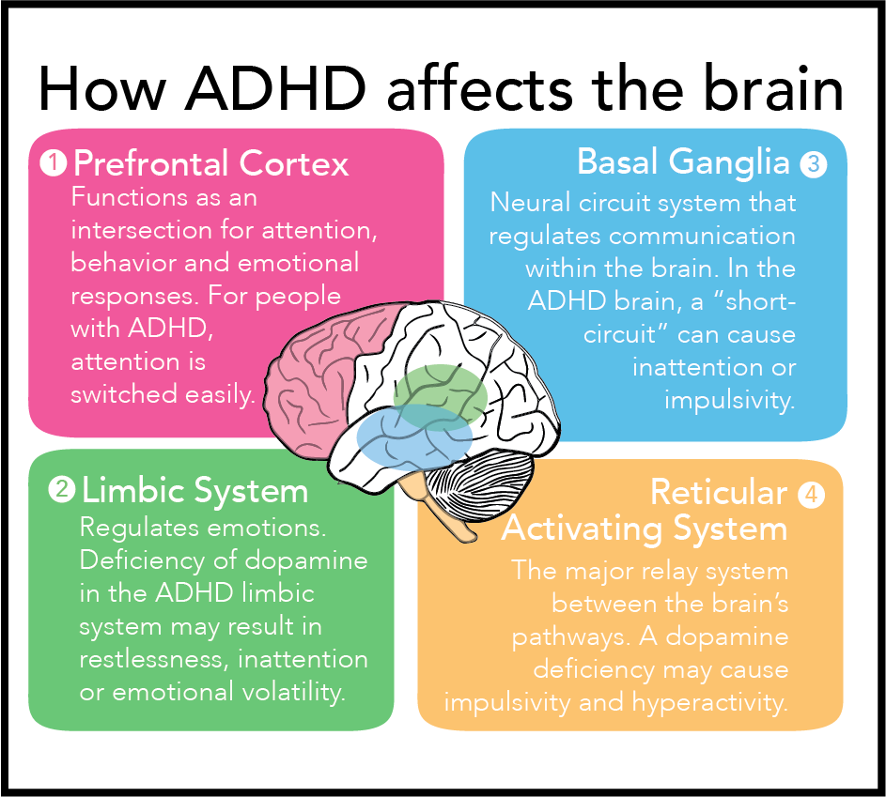
Source: The Appalachian Online
Notes:
Frontal cortex: manages and controls high-level functioning such as directing and organizing attention, as well as executive function and more
Limbic system: coordinates emotional and behavioral responses
Basal ganglia: directs communication within the brain, similar to the control tower of an airport. It is heavily involved in motor coordination as well as habit formation, rewards and reinforcement
Reticular activating system (RAS): a network of neurons that aid the hypothalamus in regulating behavior
Frontal Lobes: Executive functioning- control impulses, emotional regulation, motivation, organization and sequential memory
Cerebellum: helps regulate executive functioning
Basal Ganglia: helps regulate activity and helps integrate feelings as well as learned behaviors
Limbic System: Emotional center

Slide 34
Executive Functioning- The CEO of the Brain
Behaves “automatically” with day to day functions we take for granted
Helps with focus, staying attentive and ignoring external stimuli
Strategizes and motivates behavior
Hyperfocus- things they are interested in, they can become overly focused (phone, games)
Sets Goals: Deficiency in “complex problem solving” – needs to do one step at a time
Notes:
With ADHD the child can be “hypersensitive” to their sensory environment

Slide 35
The Limbic System- The Emotional CEO
ADHD brains feel things HARD
Makes one easily frustrated and unpredictable
Makes regulating behaviors difficult
The nucleus accembens, a part of the reward center is underdeveloped which increases risk of addiction and impulsivity
Difficulty picking up nonverbal cues from their emotional environment (dangerous and normal)
Notes:
With ADHD the child can be “hypersensitive” to their sensory environment

Slide 36

Neurotransmitters and ADHD

Slide 37
Biochemistry of the Brain
The brain uses multiple chemical substances for operation, regulation and communication
To pay proper attention the brain must be adequately controlled, repressed or slowed down by these chemical messengers
Dopamine: helps to repress our impulses, compulsivity, and addictive behaviors. *reward center*
Serotonin: regulates emotions, sleep, energy level, impulsivity and moods
Norepinephrine: helps us sustain focus and attention.
Adrenaline: plays a key role in the body's "fight or flight" response, preparing the body to react to stressful situations
GABA: its main function is to calm down nerve cells and produce a calming effect
Notes:
GABA: playing a crucial role in regulating anxiety, stress, fear, and sleep cycles by reducing the activity of neurons in the central nervous system
Adrenaline by rapidly increasing heart rate, blood pressure, and blood sugar levels, while also directing blood flow towards muscles to enable quick action; essentially providing a surge of energy to deal with a perceived threat

Slide 38
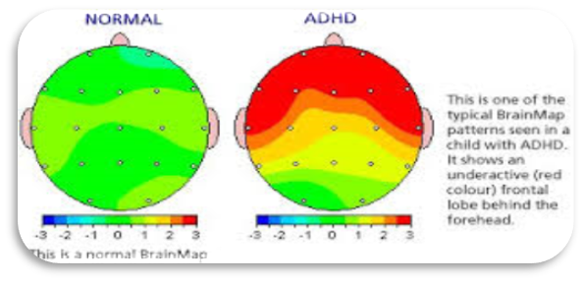
Neurotransmitters & ADHD
Dopamine-low levels appear to be linked to impulsive and risk taking behaviors and rewards seeking behaviors
Serotonin- low levels affect mood, sleep, aggression and shifting attention
Norepinephrine- low levels decrease ability to sustain focus on a task, plan ahead, and understand concepts such as sequence and time
Adrenaline plays a significant role in procrastination, often acting as a "last-minute push" where individuals with ADHD may rely on the surge of adrenaline.
GABA- lower levels lead to difficulties with behavioral inhibition, increased impulsivity, impaired attention control, and struggles with regulating excitement
Notes:
from a looming deadline to focus and complete tasks, leading to a pattern of delaying work until the very last moment due to the perceived need for that pressure-induced energy boost
Inattention and distractibility appear to be related to low levels of Norepinephrine. ADHD Children/Adults can't judge which things in their environment are important and which should be ignored. ADHD Children/Adults often feel the flight path of a fly in the room is as important as the teacher's algebra lesson. To the ADHD Child/Adult, everything on the desk is equally interesting and worthy of attention. Low levels of Norepinephrine also make it very difficult for ADHD Children/Adults to sustain their focus on a task, plan ahead, and understand such concepts as sequence and time.
The impulse and behavior problems found in Attention-Deficit Hyperactivity Disorder (ADHD) appear related to low levels of Dopamine in the brain. When dopamine levels are normal, we can repress the urge to do or say something in public, grab something interesting on a desk, blurt out our opinion, or touch/poke someone who has just walked within our physical range. Low levels of dopamine in the brain makes control of impulsive behavior almost impossible in the ADHD Child/Adult.

Slide 39
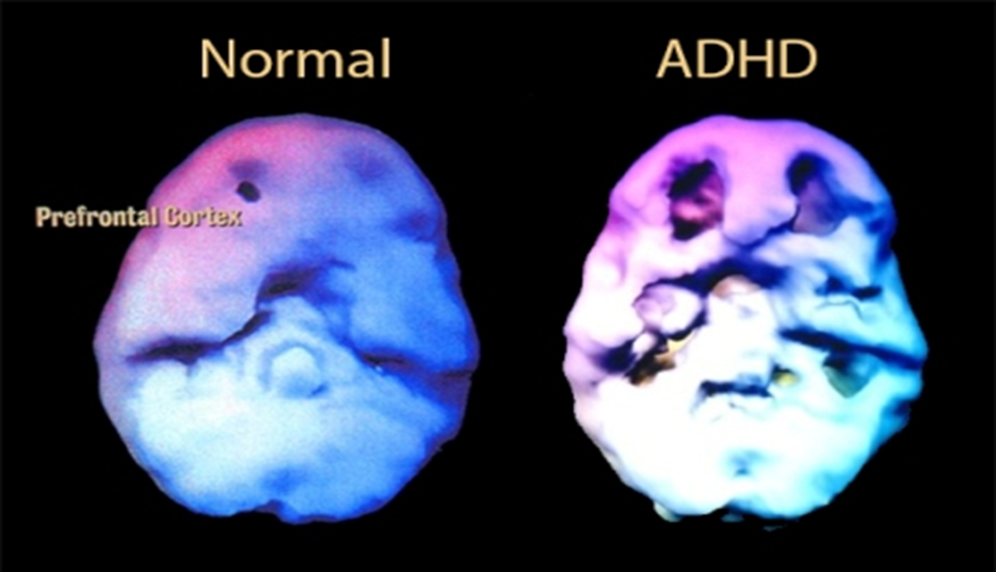
Dopamine Deficiency
ADHD is caused by insufficient norepinephrine and deficiencies in the dopamine system in four main sections of the brain: the frontal cortex, the limbic system, the basal ganglia and the reticular activating system
People with ADHD are often found to have deficits in the reward centers of the brain, particularly the dopamine system.
Notes:
https://www.unlockingadhd.com/adhd-from-a-scientific-point-of-view/
where children may have low dopaminergic characteristics. ADHD stems from insufficiency of a particular neurotransmitter: norepinephrine (a.k.a. noradrenaline). Each molecule of norepinephrine is composed of dopa. Dopa molecules are converted into dopamine, which is then converted into norepinephrine. ]

Slide 40

The Perfect Storm:
ADHD and the Brain..and Young Adults
An under aroused brain looking for stimulation
An uninhibited brain: Low GABA
Frontal lobe takes longer to mature
Limbic System dominant
30% less chronological age in executive functions
Genetics: The apple does not fall far from the tree.
Lower Dopamine: Risk taking, reward seeking
Notes:
Low dopamine: Bored brain
With an appropriate level of GABA you can control impulses

Slide 41

Age Matters
Younger Brains are More Susceptible Than Adults to Alcohol and/or Other Substances
It takes 8-10 years for an adult to travel from experimentation with alcohol and/or other drugs to becoming chemically dependent.
It takes a teenager anywhere from 3-15 months.
Notes:
Neural circuitry underlying adolescent vulnerability to substance use disorder (SUD). Current theories on the etiology of SUD indicate addiction results from an executive function deficit (A), increased incentive salience of drug-related cues (B), and the formation of compulsive drug habits (C). Adolescence is a sensitive period of ongoing neurodevelopment in which these traits are expressed even in the absence of drug taking. Specifically, adolescents exhibit A) poor executive control, resulting from reduced inhibitory control of the orbitofrontal cortex (OFC), dorsolateral PFC (DL), and anterior cingulate cortex (ACC), over more developed subcortical regions such as the striatum (S) and subthalamic nucleus (STN). Adolescents also attribute B) increased incentive salience to reward-related cues, due to elevated excitation in projections between the ventromedial PFC (VM), the ventral striatum (including the nucleus accumbens) and amygdala (A). Finally, adolescents are more prone to C) formation of habitual over goal-directed behaviors. Habit formation in adults involves a progressive recruitment (increased activation) of the VMPFC to the ventral striatum (pathway 1) followed by increased activity in the ACC (pathway 2), to the striatum (pathway 3), and motor cortex (pathway 4). In contrast, adolescents show evidence of direct excitatory projections between the VMPFC and dorsal striatum (S), providing a shortcut to the formation of habits.

Slide 42

Testimonies
In college, “My mind was so out of control, and drinking would make that go away. I didn’t drink to get smashed, but to concentrate and get my homework done.” “The boredom was impossible. I could be sitting in an interesting lecture and be totally bored. When I drank, I didn’t care that I was bored.”
“The impulsivity, poor judgment, and social awkwardness that often come with ADHD paved the way to overindulgence, regardless of the consequences. I felt that having ADHD made it hard for me to fit in — except with the crowd that smoked marijuana. They accepted me. I used to think, ‘They don’t care if I’m a little crazy, if I don’t finish sentences, and walk out of the room while they’re talking.'”

Slide 43

Treatment and Interventions

Slide 44
Psychopharmacology Interventions
Stimulants: allow kids to “tune down” the volume around them
Mechanism of Action: Increase dopaminergic and noradrenergic activity in frontal cortex
Alternatives: Non stimulants & ant-depressants
Will they become addicted to their stimulant?
Consistent with findings in untreated ADHD in adults, untreated ADHD was a significant risk factor for SUD in adolescence. In contrast, pharmacotherapy was associated with an 85% reduction in risk for SUD in ADHD youth.

Slide 45
8 WORST THINGS TO SAY TO PEOPLE WITH ADHD
“You’re fine. Everyone has a short attention span now.”
“You just need to try harder.”
“Why can’t you just sit still?”
“ADHD isn’t a real disorder.”
“You’re just being lazy.”
“You’re just using ADHD as an excuse.”
“You’ll grow out of it.”
“You should be over this by now.”
Source: https://www.amenclinics.com/blog/scary-ways-marijuana-impacts-the-developing-brain/#:~:text=%E2%80%9CYou%20just%20need%20to%20try%20harder.%E2%80%9D&text=This%20neurological%20condition%20affects%20the,they're%20trying%20to%20manage.
Notes:
National Institute on Drug Abuse. (2022). Cannabis (marijuana) drugfacts.
Miech, R. A., Johnston, L. D., Patrick, M. E., O’Malley, P. M., Bachman, J. G., & Schulenberg, J. E. (2023). Monitoring the Future National Survey Results on Drug Use, 1975–2022: Secondary School Students. Ann Arbor: Institute for Social Research, The University of Michigan.

Slide 46
Adult ADHD Recommended Reading
Holderness, P., & Holderness, K. (2024). ADHD is Awesome: A guide to (mostly) thriving with ADHD. Harper Horizon.
Kelly, K. and Ramundo, P. (1993), You Mean I'm Not Lazy. Stupid. or Crazy?! Cincinnati: Tyrell and Jerem Press.
Murphy, K. and LeVert, S. (1995). Out of the Fog: Treatment Options and Coping Strategies for Adult Attention Deficit Disorder. New York: Hyperion.
Nadeau, K. A Survival Guide for High School and College Students with ADHD, New York: Magination.
Quinn, P.O. (1994). ADD and the College Student: a Guide for High School and College Students with Attention Deficit Disorder. New York: Magination.

Slide 47
ADHD Recommended Reading For Parents
Barkley, Russell. Taking Charge of ADHD: The Complete Authoritative Guide for Parents,
Fowler, M.C. (1990). Maybe You Know My Kid: A Parent’s Guide to Identifying, Understanding, and Helping Your Child with Attention-Deficit Hyperactivity Disorder. New York: Carol.
Hallowell. Edward and Ratey, John, Driven to Distraction: Recognizing and Coping with Attention Deficit Disorder From Childhood through Adulthood. Patheon Books.
Hallowell. Edward and Ratey, John, Delivered from Distraction: Getting the most out of Life with Attention Deficit Disorder. Patheon Books.
Jensen, Peter. Making the System Work For Your Child with ADHD. Guilford Press.
Ingersoll, B. (1988). Your Hyperactive Child. New York: Doubleday.
Ingersoll, B. and Goldstein, S. (1993). Attention Deficit Disorder and Learning Disabilities, New York: Doubleday.
Honos-Webb, Lara. The Gift Of ADHD: How To Transform Your Child's Problems Into Strengths. Oakland: New Harbinger.
Taylor, Blake. ADHD and Me: What I Learned from Lighting Fires and the Dinner Table. New Harbinger: 2008.

