Slide 1
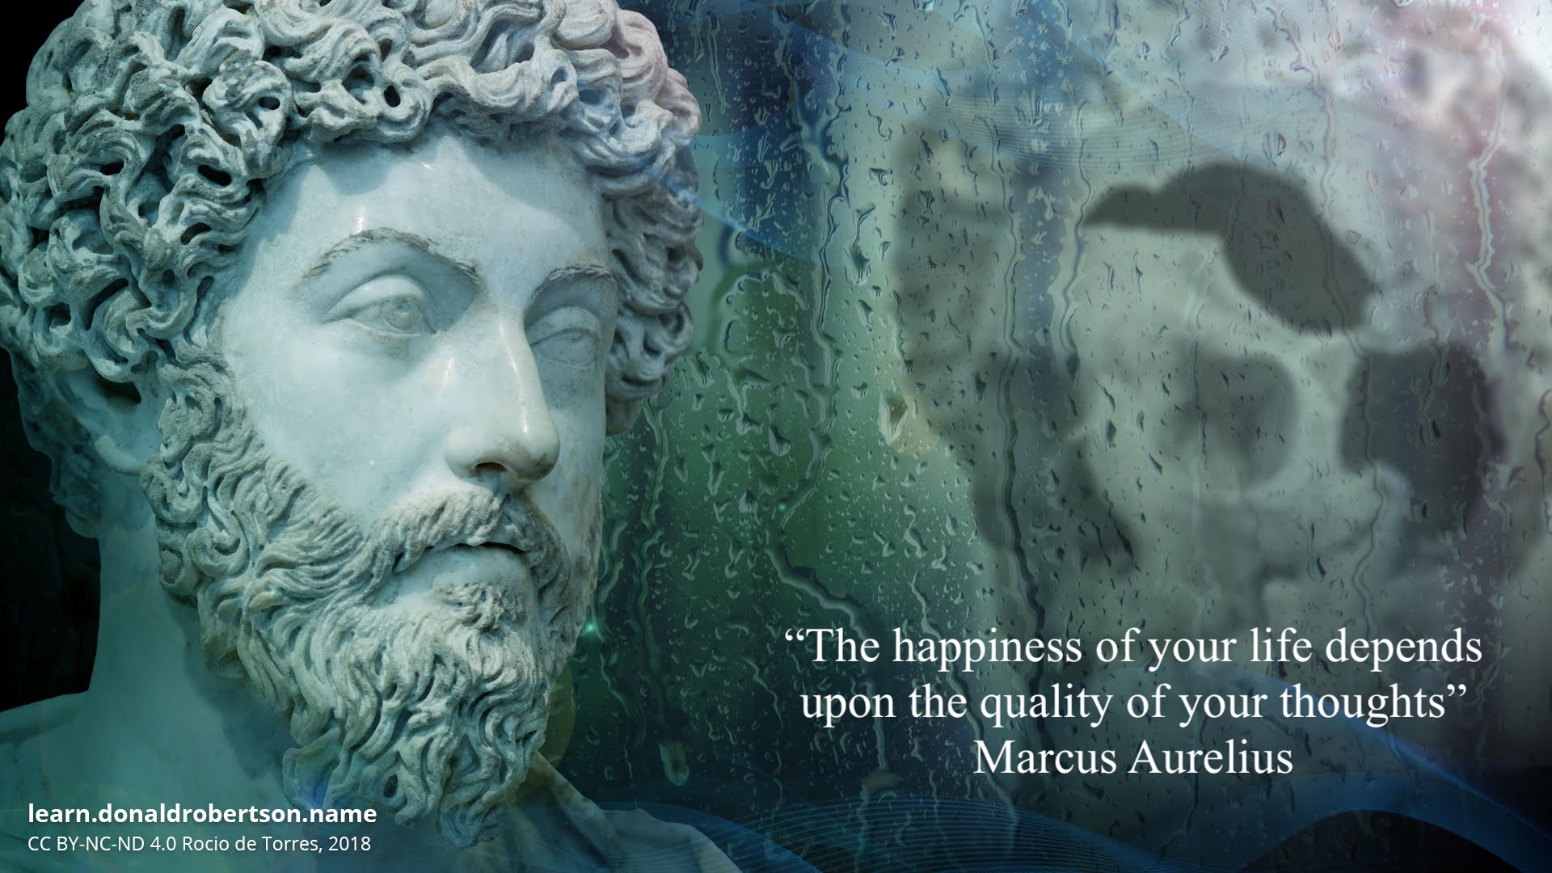
Stoicism & Recovery
Inner Strength Through Ancient Wisdom Frank Iovine

Slide 2
What Is Stoicism?
- Ancient Greek & Roman philosophy
- Focus on virtue, reason, control of thoughts
- Not emotionless—mastery of response
- Its the ability to harness positive joyful emotions and accept negative ones regarding them as not useful

Slide 3
Recovery
- Recovery Intellect over emotion,
- Does this need to be said now, by me, by me now
Say what you mean, mean what you say, but don’t say it meanly

Slide 4
Stoicism Marcus Aurelius
- Treat with utmost respect your power of forming opinions, for this power alone guards you against making assumptions that are contrary to nature and judgments that overthrow the rule of reason. It enables you to learn from experience, to live in harmony with others, and to walk in the way of the gods.
"YOU ALWAYS OWN THE OPTION OF HAVING NO OPINION. THERE IS NEVER ANY NEED TO GET WORKED UP OR TO TROUBLE YOUR SOUL ABOUT THINGS YOU CAN'T CONTROL.”

Slide 5
Why Stoicism for Recovery?
- Anchors us in what we can control, Recovery quiets down monkey brain or the committee
- Breaks reactivity cycles, stop analyses paralysis
- Builds resilience & emotional clarity
- Question: Why are these things important in Recovery

Slide 6
My Recovery
- In my experience as a recovered alcoholic I needed something to guide my thinking that was inline with AA/recovery but left the god thing out and Stoicism did that
Will everyone gravitate to it no, its another tool for you to offer and like in recovery if you have the ability to be honest with yourself its a guideline to success

Slide 7
The God Thing
Now during ancient Roman times Gods were plentiful but even the stoics had a understanding that Gods were not for everyone they were: Pantheist
Which is: a doctrine which identifies God with the universe, or regards the universe as a manifestation of God.
Worship that admits or tolerates all gods (“bring your own”)

Slide 8
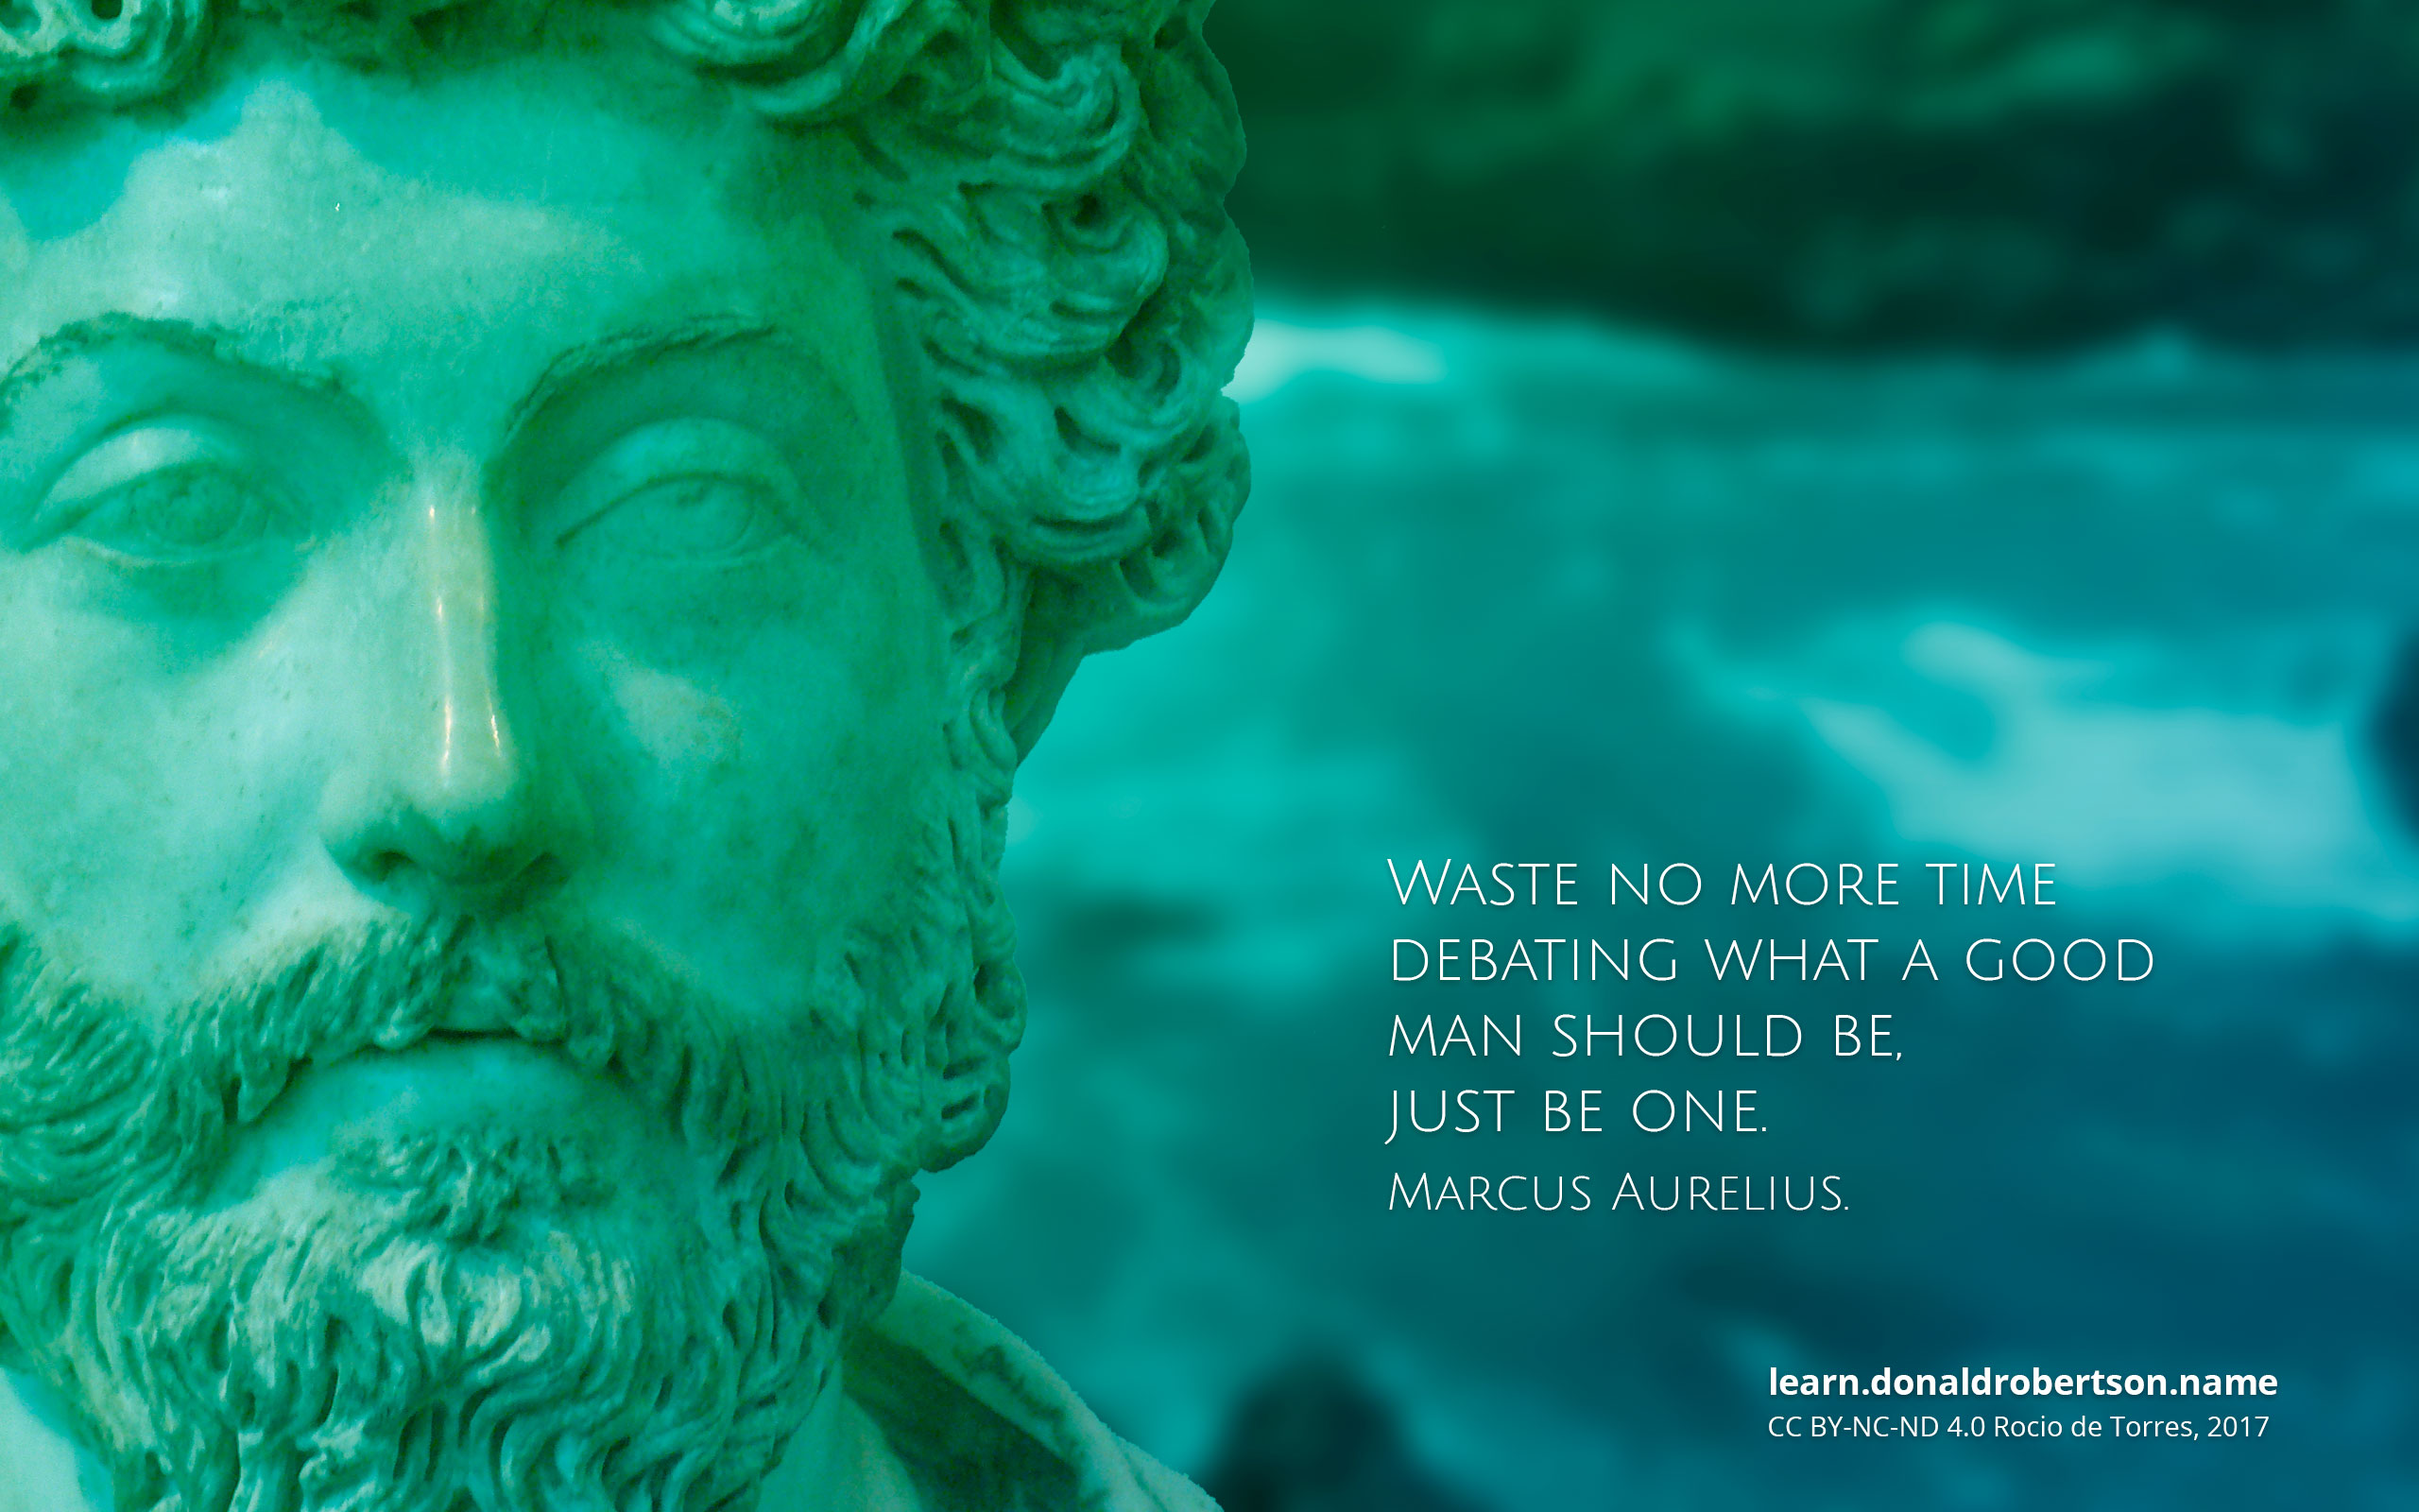
Marcus Aurelius
Meditations a journal to himself

Slide 9
The Stoic Dichotomy of Control
"Some things are up to us and some are not." – Epictetus
- Up to us: thoughts, actions, mindset
- Not up to us: outcomes, others, the past
- Aligns with Serenity Prayer

Slide 10
Blame
"The chief task in life is simply this: to identify and separate matters so that I can say clearly to myself which are externals not under my control, and which have to do with the choices I actually control. Where then do I look for good and evil? Not to uncontrollable externals, but within myself to the choices that are my own."
—EPICTETUS, DISCOURSES, 2.5.4-5

Slide 11
Epictetus
”Every event has two handles-one by which it can be carried, and one by which it can't. If your brother does you wrong, don't grab it by his wronging, because this is the handle incapable of lifting it. Instead, use the other - that he is your brother, that you were raised together, and then you will have hold of the handle that carries."
- EPICTETUS, ENCHIRIDION, 43
Identify the 2 events and grab the better handle

Slide 12
Event has 2 Handles
The famous journalist William Seabrook suffered from such debilitating alcoholism that in 1933 he committed himself to an insane asylum, which was then the only place to get treatment for addiction. In his memoir, Asylum, he tells the story of the struggle to turn his life around inside the facility. At first, he stuck to his addict way of thinking —and as a result, he was an outsider, constantly getting in trouble and rebelling against the staff.
He made almost no progress and was on the verge of being asked to leave.
Then one day this very quote from Epictetus - about everything having two handles —occurred to him. "I took hold now by the other handle," he related later, "and carried on." He actually began to have a good time there.
He focused on his recovery with real enthusiasm. "I suddenly found it won-derful, strange, and beautiful, to be sober. ... It was as if a veil, or scum, or film had been stripped from all things visual and auditory." It's an experience shared by many addicts when they finally stop doing things their way and actually open themselves to the perspectives and wisdom and lessons of those who have gone before them.
There is no promise that trying things this way —of grabbing the different handle - will have such momentous results for you. But why continue to lift by the handle that hasn't worked?

Slide 13
Core Stoic Principles
- Live by nature and reason
- Cultivate virtue over pleasure
- Reframe adversity as training
- Practice presence
Lets define these?

Slide 14
The 4 Cardinal Stoic Virtues
Wisdom – Right judgment
Courage – Face discomfort
Justice – Integrity & fairness
Temperance – Self-restraint & balance

Slide 15
Virtues associated w/Stoicism
Gratitude
Humility
Mindfulness
Self-Awareness
Compassion
Equanimity

Slide 16
Gratitude
- Focuses the mind on what is present
- Shifts perspective from lack to abundance
- Reduces resentment and craving

Slide 17
Resilience (Fortitude)
- Endure hardship with dignity
- View pain as training, not punishment
- A core theme in Epictetus and Marcus Aurelius

Slide 18
Humility
- Recognize limits and stay teachable
- Essential for growth and healing
- Builds openness and reduces ego

Slide 19
Mindfulness
- Anchors us in the present moment
- Helps manage emotions and cravings
- “The present is all you ever possess” – Marcus Aurelius

Slide 20
Self-Awareness
- Know your thoughts and triggers
- Foundation of self-mastery
- Developed through reflection and journaling

Slide 21
Contentment
- Find satisfaction in simplicity
- Let go of external validation
- “Having few wants” brings peace – Epictetus

Slide 22
Compassion
- Practice justice with kindness
- Understand others act from ignorance
- Respond with fairness, not anger

Slide 23
Discipline (Self-Mastery)
- Govern your impulses
- Build inner strength through habits
- Crucial for sobriety and personal growth

Slide 24
Equanimity
- Stay calm in both joy and adversity
- Balance emotions without suppression
- The Stoic path to serenity

Slide 25
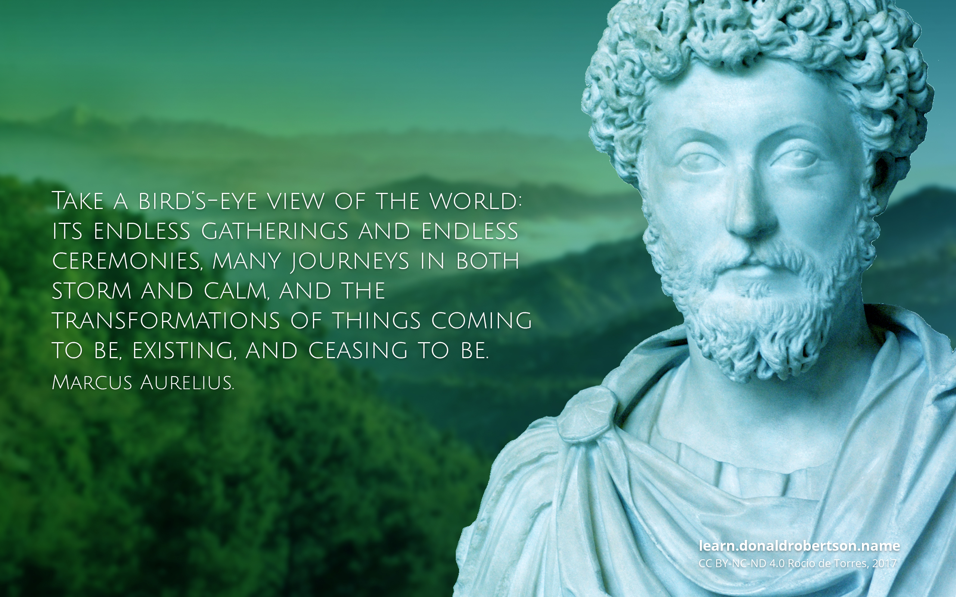

Slide 26
Reframing Challenges
- See struggles as teachers
- Ask: What can I learn?
- Respond, don't react

Slide 27
Journaling as a Stoic Tool
- Inspired by Marcus Aurelius
Prompts:
• What is in my control?
• How did I respond today?
• What virtue did I practice?

Slide 28
Amor Fati & Radical Acceptance
"Love your fate" – Embrace what is
- Don’t resist reality
- Use setbacks as fuel for growth

Slide 29
Practical Stoic Practices
- Morning intention: What virtue today?
- Evening reflection: What went well?
- Negative visualization
- Voluntary discomfort

Slide 30
Stoic Quotes to Reflect On
"You have power over your mind..." – Aurelius
"If it’s endurable, then endure it." – Aurelius
"No man is free who isn’t master of himself." – Epictetus

Slide 31
Interactive Journaling Prompt
- Identify a struggle
- Is it in your control?
- What virtue applies?
- Reframe the situation

Slide 32
Group Reflection & Discussion
- Share takeaways
- Practice active listening
- Embrace the journey, not perfection

Slide 33
Daily Stoic Recovery Toolkit
- Control what you can
- Practice virtue daily
- Reframe, reflect, re-center

Slide 34
Quote from Marcus Aurelius – Book 3, 4
“Purge your mind of all aimless and idle thoughts, especially those that pry into the affairs of others or wish them ill.”

Slide 35
Quote on Inner Strength
“You have power over your mind—not outside events. Realize this, and you will find strength.”

Slide 36
Quote on the Mind’s Character
“Such as are your habitual thoughts, such also will be the character of your mind: for the soul is dyed by the thoughts.”
— Marcus Aurelius (121–180 AD)

Slide 37
Closing & Resources
- Read: Meditations, Discourses, Letters from a Stoic
- Follow: The Daily Stoic
- Reminder: The obstacle is the way

