Slide 1
Affirmation Art: Using Positive Affirmations to Strengthen Recovery
An interactive workshop combining creative expression and affirmations to enhance recovery outcomes.
Created by:
Erica Jennett, LPC
Presented by:
Kristen Robinson, BS, LADAC II, QCS

Slide 2
Meet The Presenter
Kristen Robinson
THRIVE Recovery Program Creator at Village Behavioral Health
B.S. in Social Work & Criminology
LADAC II, QCS
Loves her husband, Loves 90's Hip HOP, & Jeopardy

Slide 3

Diamonds in the Dumpster: A Hope Dealer’s Story

Slide 4
Learning Objectives
Explore
Explore how affirmation art supports recovery through self-awareness, self-compassion, and resilience.
Understand
Understand psychological research on affirmations and their impact on mindset and behavior.
Craft
Participate in hands-on activities: 'I Am' Collage and Affirmation Bookmarks.
Learn
Learn ways to integrate affirmation art in therapy, peer support, and group settings.

Slide 5
What are Positive Affirmations
Positive affirmations are self-directed, intentional statements designed to challenge harmful or unhelpful internal dialogue and replace it with empowering, constructive beliefs. They are often short, memorable, and deeply personal, making them easy to integrate into daily life.
Purpose:
They serve as tools to redirect thought patterns, shift focus away from self-criticism and encourage the development of a growth-oriented mindset. When repeated consistently, affirmations can help reframe negative experiences and promote emotional resilience.
Theoretical Foundation – Self-Affirmation Theory (Steele, 1988):
This psychological framework proposes that people are motivated to protect their self-integrity—their sense of moral adequacy and self-worth. By affirming personal values and strengths, individuals can reduce defensiveness, handle criticism more constructively, and maintain psychological balance during stress.
Benefits for Recovery:
In the context of recovery, affirmations can counteract internalized stigma, improve self-worth, and strengthen motivation for change. They act as mental “anchors” during difficult moments, reminding individuals of their inherent value and capacity for growth.
Examples:
“I am worthy of love and respect.”
“I have the strength to overcome challenges.”
“I am becoming the best version of myself.”

Slide 6
How Affirmations Work
In the Brain
Affirmations light up reward-related brain areas, particularly the ventral striatum and ventromedial prefrontal cortex (vmPFC)—regions involved in valuation and self-processing (Dutcher & Creswell, 2020).
They decrease threat sensitivity by increasing connectivity between reward networks and lowering activity in the anterior insula, helping to dampen stress responses (Dutcher & Creswell, 2020).
Recent findings confirm that activation of self-processing and reward circuits through affirmations is associated with enhanced emotional regulation and improved recovery outcomes (Tiwari et al., 2025).

Slide 7
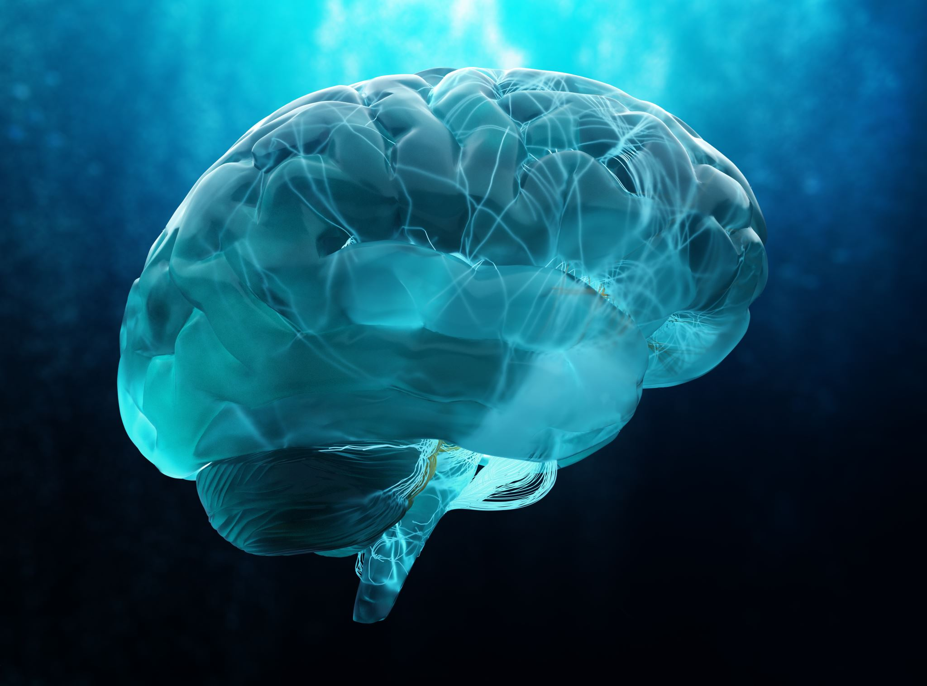
Benefits of Affirmations
Reduce stress and anxiety:
Regular practice of positive affirmations has been shown to activate brain regions linked to emotional regulation, such as the ventromedial prefrontal cortex, which can buffer stress responses and lower physiological indicators of anxiety (Dutcher & Creswell, 2020). This makes affirmations a practical self-care tool for reducing daily stress levels.
Improve self-esteem and mood:
Affirmations help individuals replace negative self-talk with empowering statements, which improves overall mood and self-worth. Research indicates that consistent use can lead to measurable increases in self-esteem, particularly in populations facing high stress or stigma (Wellspring Prevention, 2024).
Enhance resilience and adaptive functioning:
By reinforcing core personal values, affirmations support resilience—the ability to recover from setbacks—while also enhancing adaptive coping strategies (Cascio et al., 2016; Tiwari et al., 2025). This benefit is particularly relevant in recovery settings where persistence and adaptability are key.
Boost academic and personal performance:
In educational contexts, affirmations have been shown to reduce stereotype threat and improve academic outcomes, especially among marginalized groups. This effect translates into personal growth and performance improvement in both academic and workplace environments (Cohen et al., 2006).

Slide 8
Best Practices for Crafting Affirmations
Use simple, believable, present-tense statements: Short, easy-to-remember phrases signal to the brain that the statement is already true, strengthening positive neural pathways.
Frame in positive language aligned with personal values: Focus on what you want to achieve, not what to avoid, ensuring affirmations resonate deeply.
Practice daily in a relaxed state: Integrate affirmations into calm moments, like morning routines or before sleep, for better absorption.
Use reminders like sticky notes, journal prompts, or art displays: Surround yourself with visual cues that make affirmations part of daily life.

Slide 9
Therapeutic Applications
Cognitive behavioral therapy (CBT) integration: affirmations replace harmful, negative self-talk with empowering statements, supporting cognitive restructuring.
Digital CBT and telehealth: embedding affirmations in digital CBT modules or mobile apps increases self-efficacy and treatment adherence.
Resilience and stereotype threat reduction reinforces personal worth in marginalized populations, boosting resilience and performance under pressure.
Trauma-informed practice: tailors affirmations to focus on safety, empowerment, and self-compassion to aid trauma recovery.

Slide 10
Incorporating Affirmation Art in Recovery
Integrate into group therapy, individual sessions, and peer support:
Affirmation art can be used as an icebreaker activity in group therapy, helping participants connect over shared values and strengths. In individual counseling, it becomes a personalized therapeutic tool that can be revisited across sessions. In peer support settings, collaborative affirmation projects can promote mutual encouragement and strengthen community bonds (Creswell et al., 2020).
Combine with mindfulness, journaling, and gratitude exercises:
When paired with mindfulness, affirmation art allows participants to stay present while creating something meaningful. Integrating it into journaling or gratitude practices can deepen self-reflection and help participants recognize positive progress in recovery (Therapist Aid, 2023). For example, a journaling prompt could be: “Describe a time you embodied the affirmation on your artwork.”
Display in communal spaces to inspire positivity:
Finished pieces can be displayed in group rooms, community centers, or residential facilities to create an environment infused with encouragement. This not only provides daily visual reinforcement for the creator but also uplifts others who see it. Rotating displays or “affirmation walls” can keep the environment fresh and engaging.

Slide 11
Affirmation Art Activity Options
Affirmation Stones
Paint or write affirmations (e.g., “I am resilient”) on smooth river rocks.
Portable reminder that can be kept on a desk or in a pocket.
Affirmation Bookmarks (Workshop Activity)
Create bookmarks with hand-written affirmations and decorate them.
A daily reminder each time participants open a book.
Positive Affirmation Vision Cards
Use index cards and magazine cutouts to create mini-affirmation cards.
Pull out daily for encouragement and reflection.
Affirmation Mirror Frames
Write affirmations on sticky notes or directly on a mirror frame.
Encourages repeating affirmations during daily routines.
Watercolor Affirmation Cards
Paint abstract backgrounds and overlay affirmations with lettering.
Combines creativity, mindfulness, and personal reflection.
“I Am” Collage (Workshop Activity)
Create collages celebrating strengths and self-beliefs beginning with “I am…”.
Encourages self-reflection, creativity, and builds a tangible reminder of self-worth.

Slide 12
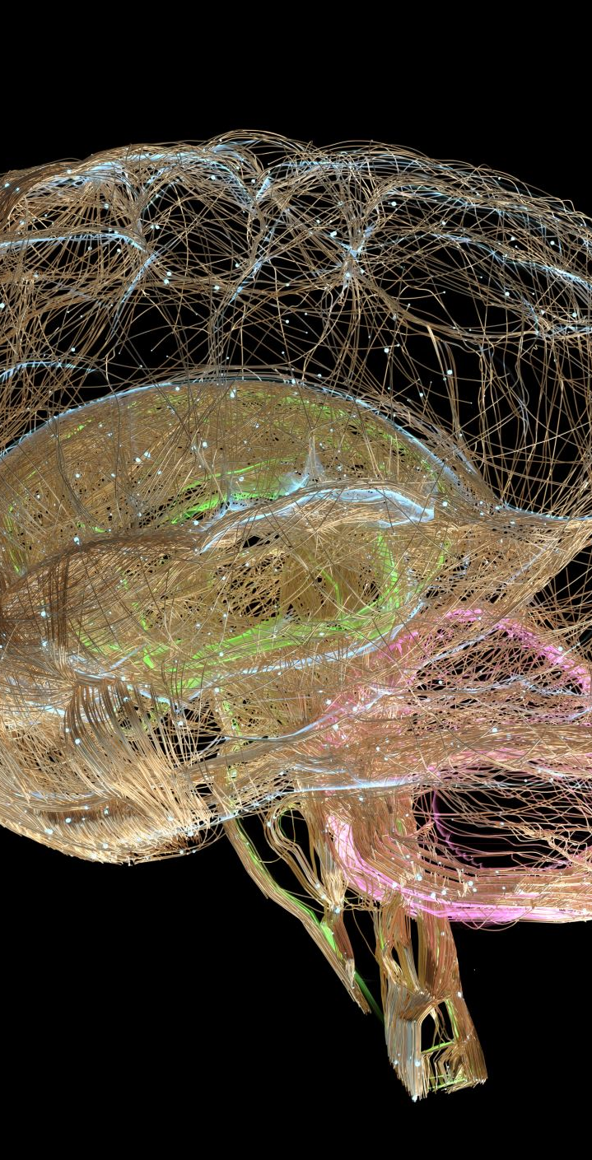
Summary and Takeaways
Affirmations can rewire the brain for positivity:
Neuroscience research shows that repeating positive affirmations can strengthen neural pathways in the brain’s self-referential and reward systems, such as the medial prefrontal cortex and ventral striatum. Over time, this neuroplasticity makes positive thinking more automatic, helping individuals respond to challenges with resilience rather than self-criticism (Cascio et al., 2016; Dutcher & Creswell, 2020).
Creative art makes affirmations more personal and engaging:
Combining affirmations with creative expression—through visual art, collage, or craft—activates both analytical and emotional brain networks. This process deepens emotional connection to the affirmation, making it more memorable and meaningful. Tangible, hands-on creation also reinforces mindfulness, allowing individuals to be present with their thoughts and feelings while building something uplifting (Therapist Aid, 2023).
Affirmation art can strengthen recovery outcomes across diverse settings:
Whether in group therapy, one-on-one counseling, residential treatment, or peer support programs, affirmation art offers a flexible, adaptable tool that promotes hope, self-worth, and motivation. When integrated into broader recovery plans, it can enhance engagement, reduce dropout rates, and foster a sense of agency in participants’ own healing journey (Wellspring Prevention, 2024).

Slide 13

'I Am' Collage Activity
Purpose: Create a visual collage celebrating personal strengths, positive traits, and affirmations beginning with 'I am…'.
Process: Use magazines, printed words, drawings, and photos to build a personal representation of self-worth.
Therapeutic Benefits: Encourages self-reflection, creativity, and mindfulness through the engagement of both analytical and emotional processes.
Recovery Connection: Serves as a tangible reminder of strengths, helpful in maintaining motivation during difficult moments.

Slide 14

Affirmation Bookmarks Activity
Purpose: Create personalized bookmarks with hand-written affirmations that serve as daily reminders of strength and positivity.
Process: Use cardstock strips, markers, stickers, washi tape, or other art supplies to decorate bookmarks. Write empowering affirmations on them and optionally laminate for durability.
Therapeutic Benefits: Provides a tangible and creative way to reinforce affirmations, encourages daily practice whenever participants open a book, and offers a calming, mindful activity.
Recovery Connection: Acts as a practical, portable coping tool, each time participants see their bookmark, it reinforces self-worth and resilience, especially in challenging moments.
This Photo by Unknown Author is licensed under CC BY-NC-ND

Slide 15
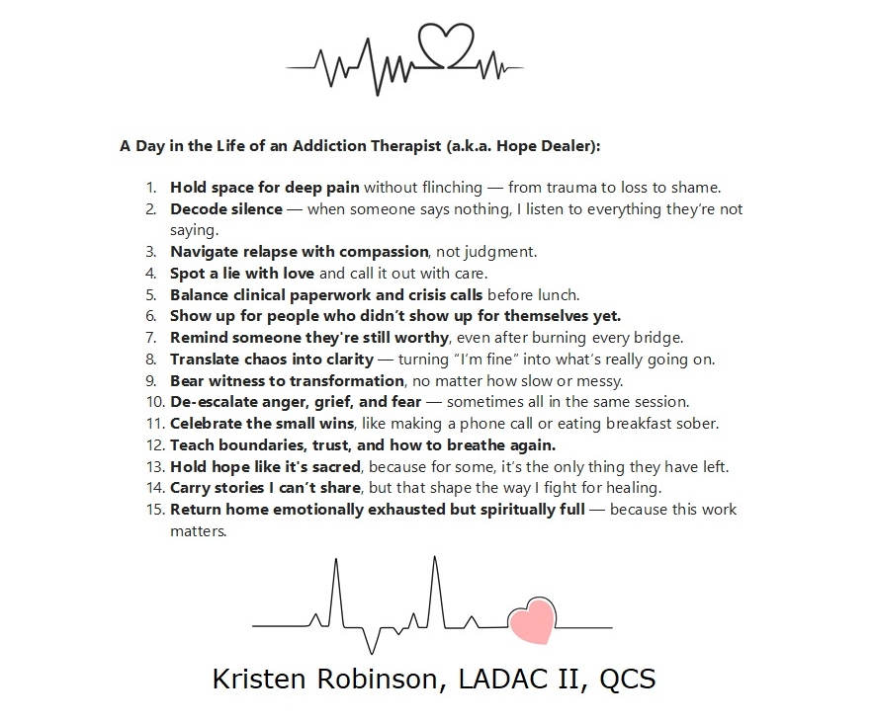

Slide 16
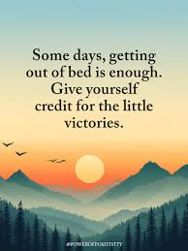
Humans can be critical of others as well as themselves.
People struggling with addiction are often even more
critical of themselves.
Observing how individuals treat others gives a window into how they treat themselves.
Affirmations are an effective way to learn and practice being kind to ourselves so that we can work on being more kind to others.
We need to be more kind to ourselves and others.

Slide 17

Questions

Slide 18
References
Cascio, C. N., O’Donnell, M. B., Tinney, F. J., Lieberman, M. D., & Falk, E. B. (2016). Self-affirmation activates brain systems associated with self-related processing and reward and is reinforced by future orientation. Social Cognitive and Affective Neuroscience, 11(4), 621–629. https://doi.org/10.1093/scan/nsv139
Cohen, G. L., Garcia, J., Apfel, N., & Master, A. (2006). Reducing the racial achievement gap: A social-psychological intervention. Science, 313(5791), 1307–1310. https://doi.org/10.1126/science.1128317
Creswell, J. D., Dutcher, J. M., Klein, W. M., Harris, P. R., & Levine, J. M. (2020). Self-affirmation improves problem-solving under stress. PLoS ONE, 8(5), e62593. https://doi.org/10.1371/journal.pone.0062593
Dutcher, J. M., & Creswell, J. D. (2020). The role of brain activity in the stress-buffering effects of self-affirmation. Social Cognitive and Affective Neuroscience, 15(10), 1086–1097. https://doi.org/10.1093/scan/nsaa124
Steele, C. M. (1988). The psychology of self-affirmation: Sustaining the integrity of the self. In L. Berkowitz (Ed.), Advances in experimental social psychology (Vol. 21, pp. 261–302). Academic Press. https://doi.org/10.1016/S0065-2601(08)60229-4
Therapist Aid. (2023). Positive psychology worksheets. Therapist Aid LLC. https://www.therapistaid.com/therapy-worksheets/positive-psychology
Tiwari, G. K., et al. (2025). Understanding the nature and dynamics of self-affirmation: A neuropsychological perspective. Neuroscience & Biobehavioral Reviews, 159, 105524. https://doi.org/10.1016/j.neubiorev.2025.105524
Wellspring Prevention. (2024, July 23). The benefits of positive affirmations. Wellspring Center for Prevention. https://wellspringprevention.org/blog/the-benefits-of-positive-affirmations/

