Slide 1

Ethical Foundations of Empowering Recovery
Kristen Robinson, LADAC II, NCAC II, QCS

Slide 2
Welcome
Objectives
Why ethics matter in addiction recovery
Brief overview of the four ethical principles

Slide 3
It’s Tricky
In recovery work, we face situations every day where it’s tricky to do the right thing. Let’s see how your decision-making beats drop.
“What’s your personal theme song when you’re navigating a challenging day in recovery work — and why?”

Slide 4
This Presentation
This presentation emphasizes the ethical principles of beneficence, non-maleficence, autonomy, and justice in addiction recovery.
It stresses the importance of respect, sensitivity, and compassion in addiction professionals' relationships with clients.

Slide 5
Key Points
Understand and apply the four ethical principles (beneficence, non-maleficence, autonomy, and justice) in addiction counseling to ensure client welfare, safety, and dignity.
Identify and implement key professional responsibilities, including non-discrimination, confidentiality, respect, accountability, and clear communication, within addiction treatment settings.
.

Slide 6
Key Points
Recognize the impact of grief and mental health issues during recovery, and develop strategies for addressing these challenges with authenticity, ethical storytelling, and diverse, individualized approaches.

Slide 7
Objectives
Explore the 4 core ethical principles
Strengthen ethical decision-making in practice
Empower clients with dignity and compassion

Slide 8
Why Ethics Matter in Recovery
Guiding relationships
Supporting vulnerability
Protecting autonomy and safety

Slide 9
The Four Core Ethical Principles in Addiction Counseling
Beneficence – Promoting well-being
Non-Maleficence – Do no harm
Autonomy – Respecting the client’s right to choose
Justice – Fairness, equity, and access

Slide 10
Beneficence
Use Story-First, Client-Led Practices
Offer Tools, Not Prescriptions
Use Psychoeducation to Build Insight, Not Shame
Honor Their Story Without Hijacking It
“My role is not to save the client—but to walk beside them as they save themselves.”

Slide 11
Non-Maleficence – Do no harm
Be Trauma-Informed in Every Interaction
Avoid Assumptions—Let the Client’s Story Lead
Use Self-Disclosure Wisely and Sparingly
Avoid “One-Size-Fits-All” Treatment
Respect Readiness and Pace
“Empowerment is protection—when clients feel ownership of their healing, they are less vulnerable to harm.”

Slide 12
Autonomy – Respecting the client’s right to choose
Honor the Client’s Lived Experience as Expertise
Offer Options, Not Ultimatums
Support Informed Choice Over Compliance
Avoid Shame-Based Language or Motivations
Hold Boundaries While Honoring Choice
“Empowered clients don’t just recover—they become resilient decision-makers.”

Slide 13
Justice – Fairness, equity, and access
Start With the Individual, Not the System
Acknowledge Cultural, Social, and Economic Inequities
Ensure Equitable Access to Choices and Resources
Ensure Equitable Access to Choices and Resources
Use Storytelling to Bridge Gaps in Understanding
“Fair isn’t everyone getting the same thing—it’s everyone getting what they need to recover with dignity.”

Slide 14
Storytelling & Empowerment
Clients as the experts in their story
Using narrative to spark insight
Balancing self-disclosure

Slide 15
The Power of Storytelling and Authenticity
Storytelling as an empowerment tool
Creating space for client narratives
Using self-disclosure ethically and wisely

Slide 16
Creating Space for Client Narratives
Be present and listen without fixing
Use open-ended prompts
Validate feelings and themes
Avoid judgment or comparison

Slide 17
Ethical Use of Self-Disclosure
Ask: Who is this for—me or the client?
Keep it brief and purposeful
Link your story to the client’s goals
Avoid shifting focus away from the client

Slide 18
Promoting Empowerment Through Ethical Practice
Encouraging autonomy while maintaining safety
Enforcing boundaries without shaming
Inspiring clients through dignity-based care

Slide 19
Respect & Compassion in Practice
Person-first language
Cultural humility
Active listening and validation

Slide 20
Building Ethical Relationships
Respect, dignity, and sensitivity
Compassionate, person-centered approaches
Cultural humility and individualized care

Slide 21
Professional Responsibilities
Non-discrimination
Confidentiality and boundaries
Clear communication and accountability
Maintaining trust and transparency

Slide 22
Addressing Grief, Loss, and Mental Health
How grief and trauma can affect recovery
Mental health and dual diagnosis considerations
Ethical and compassionate responses to client vulnerability

Slide 23
The Role of Grief and Mental Health
Loss as a relapse trigger
Treating co-occurring conditions ethically
Trauma-informed approaches

Slide 24
Boundaries as Empowerment
Holding space with structure
Teaching clients how to protect peace
Ethical enforcement of limits

Slide 25
Interactive Activity: Ethical Dilemma Scenarios
Group discussion
Decision-making tools
Debrief reflections

Slide 26
Interactive Activity: Ethical Dilemma Scenarios
Group discussion
Decision-making tools
Debrief reflections

Slide 27
Interactive Activity: Ethical Dilemma Scenarios
#1: The Boundary Blur
What ethical principles are in conflict here?
How do you honor the client’s trust while maintaining professional boundaries?
What is your responsibility in this situation?
How can you redirect the relationship back into a healthy, ethical space?

Slide 28
Interactive Activity: Ethical Dilemma Scenarios
#2: Confidentiality vs. Client Safety
What ethical principles are at play (e.g., autonomy, non-maleficence, beneficence)?
Where does confidentiality begin and end in this case?
What is your ethical responsibility regarding the other peer?
How do you approach this situation with care, clarity, and respect?

Slide 29
Interactive Activity: Ethical Dilemma Scenarios
#2: Confidentiality vs. Client Safety
What ethical principles are at play (e.g., autonomy, non-maleficence, beneficence)?
Where does confidentiality begin and end in this case?
What is your ethical responsibility regarding the other peer?
How do you approach this situation with care, clarity, and respect?

Slide 30
Group Activity Overview –
“My Recovery Snapshot”
Reflect and express part of your journey
Share in small groups with support
Practice active listening
Explore boundaries in storytelling

Slide 31
3 Writing or Drawing Prompts
One moment I knew something needed to change was…
A strength I discovered in myself was…
Something I want others to know about recovery is…
I know breakdowns led to breakthroughs because…

Slide 32
Discussion Questions
How can storytelling be empowering?
What makes a story safe to share?
How can we model storytelling ethically in our roles?

Slide 33
Reflection Activity:
“My Why in Recovery Work”
Guided journaling
Think of the trickiest work-related decision you’ve had to make (no names, no identifying details).
What was happening?
Who was involved?
Why did it feel tricky?

Slide 34
Reflection Activity:
“My Why in Recovery Work”
Guided journaling
Beneficence – Doing Good
What would “doing the most good” have looked like?
How might your actions have promoted recovery, wellbeing, or trust?

Slide 35
Reflection Activity:
“My Why in Recovery Work”
Guided journaling
Non-Maleficence – Do No Harm
What harm could have occurred if you acted differently?
Were there unintended harms you hadn’t thought about at the time?

Slide 36
Reflection Activity:
“My Why in Recovery Work”
Guided journaling
Autonomy – Respecting Choice
Whose choices and voice needed to be honored?
Were you able to give them space to decide for themselves? If not, why?

Slide 37
Reflection Activity:
“My Why in Recovery Work”
Guided journaling
Justice – Fairness and Equity
Did all people involved have equal access to support, resources, or protection?
Were any biases or systemic barriers influencing your decision?

Slide 38
Reflection Activity:
“My Why in Recovery Work”
Guided journaling
Reflection & Integration
Would you make the same decision today? Why or why not?
What principle (doing good, preventing harm, respecting choice, or fairness) guided you most strongly?
How could this experience shape your future decisions?

Slide 39
When we blend ethics with empathy, we don’t just treat
— we transform.
Our role is not to control recovery, but to create the space where it can THRIVE.

Slide 40
QUESTIONS
Kristen Robinson
(865) 321-3896
kristenrobinsonladacqcs@gmail.com

Slide 41
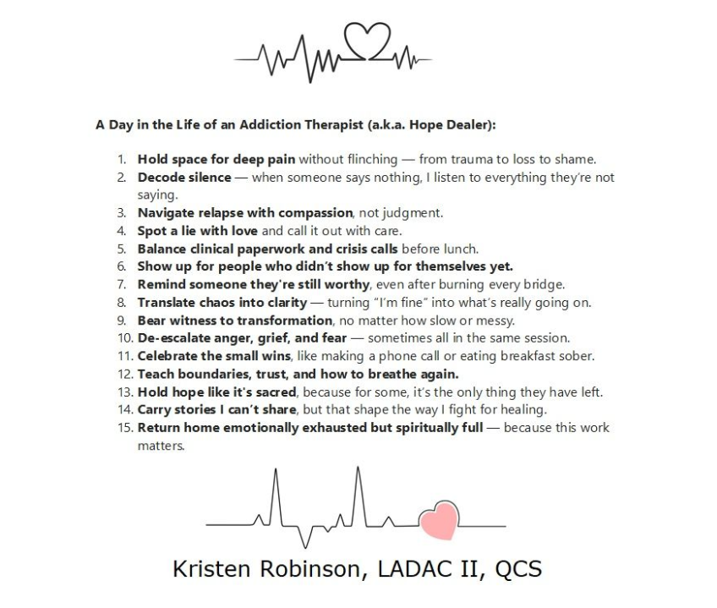

Slide 42
SOURCES
Varkey, B. (2021). Principles of clinical ethics and their application to practice. Medical Principles and Practice, 30(1), 17–28. https://doi.org/10.1159/000509119Forester-Miller, H., & Davis, T. E. (2016).
A practitioner’s guide to ethical decision making. American Counseling Association. https://www.counseling.org/docs/default-source/ethics/practioner-39-s-guide-to-ethical-decision-making.pdf
Substance Abuse and Mental Health Services Administration. (2022). Confidentiality regulations FAQs. U.S. Department of Health and Human Services. https://www.samhsa.gov/about/faqs/confidentiality-regulationsBall, S. A., & Carroll, K. M. (2011).
Ethical considerations in caring for people living with addictions. Focus, 9(1), 66–72. https://doi.org/10.1176/foc.9.1.foc66

