Slide 1
What happens in Vagus…
Trauma identification & intervention
within LADAC scope of practice
Karen moran, ladac ii, ncac ii, qcs
www.karenmorancounseling.com

Slide 2

JUST WHO AM I?
Karen Moran, LADAC II, NCAC II, QCS

Slide 3
What Is Trauma?
Traumatic Event vs. Pervasive Trauma

Slide 4
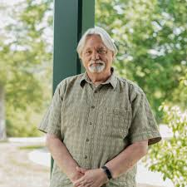
Wound Identification
*8
Conceptualized by Bobby Chapman, LADAC II, LMSW

Slide 5
RED WOUNDS
Overt Traumatic wounds
What most think about when they hear the word, “Trauma”
“The presence of something that shouldn’t have happened.”
Different from the other kinds of wounds because it is traumatic if it happened firsthand or if it is witnessed.
Creates a fundamental sense of unsafety in the world and PTSD symptoms

Slide 6
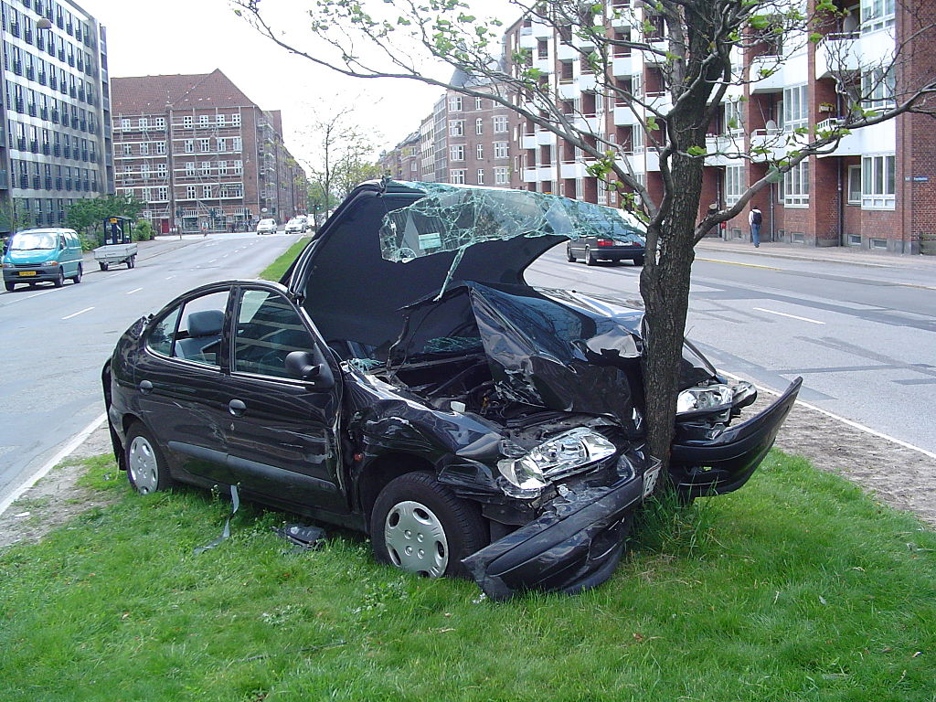
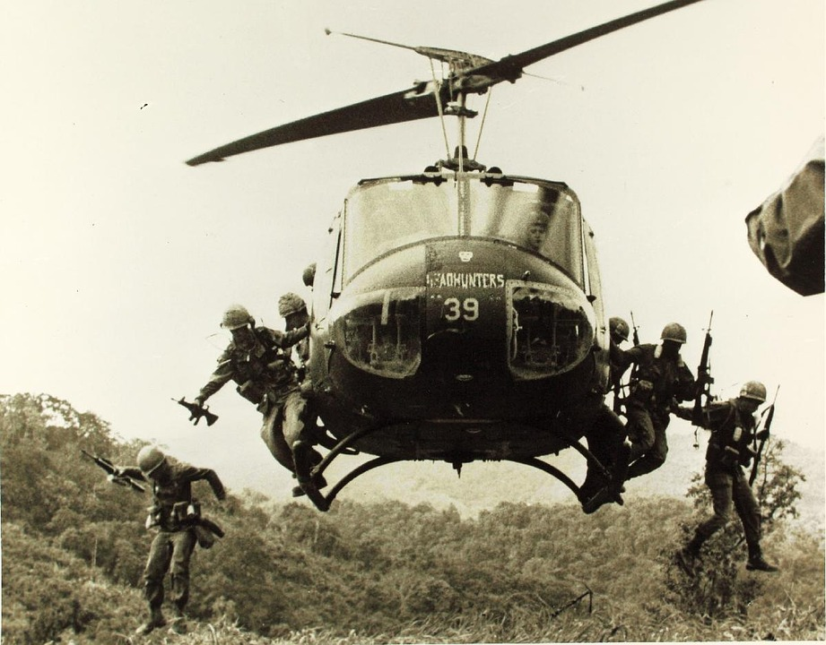
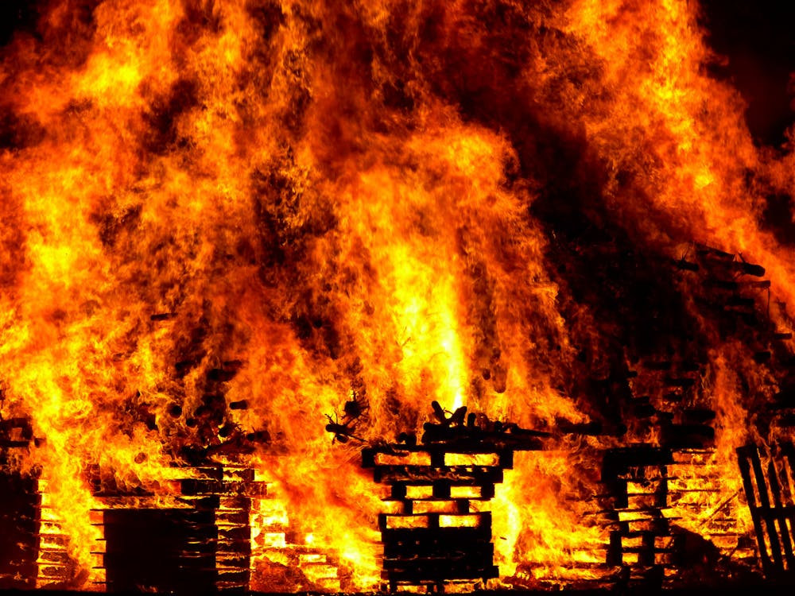
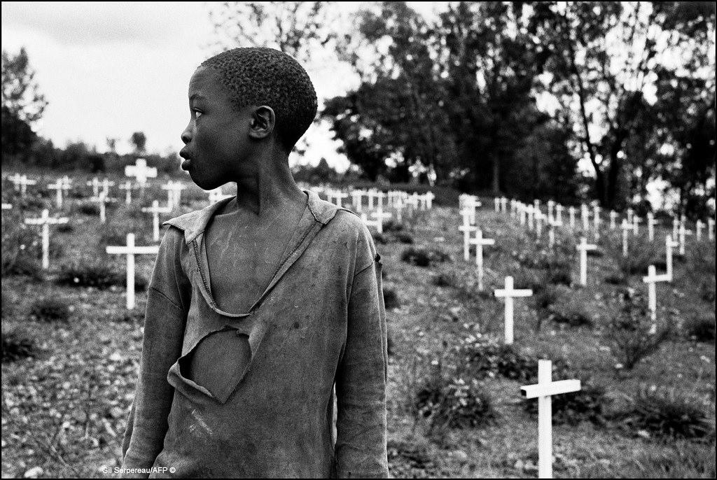
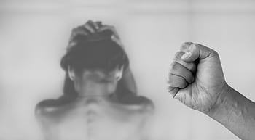
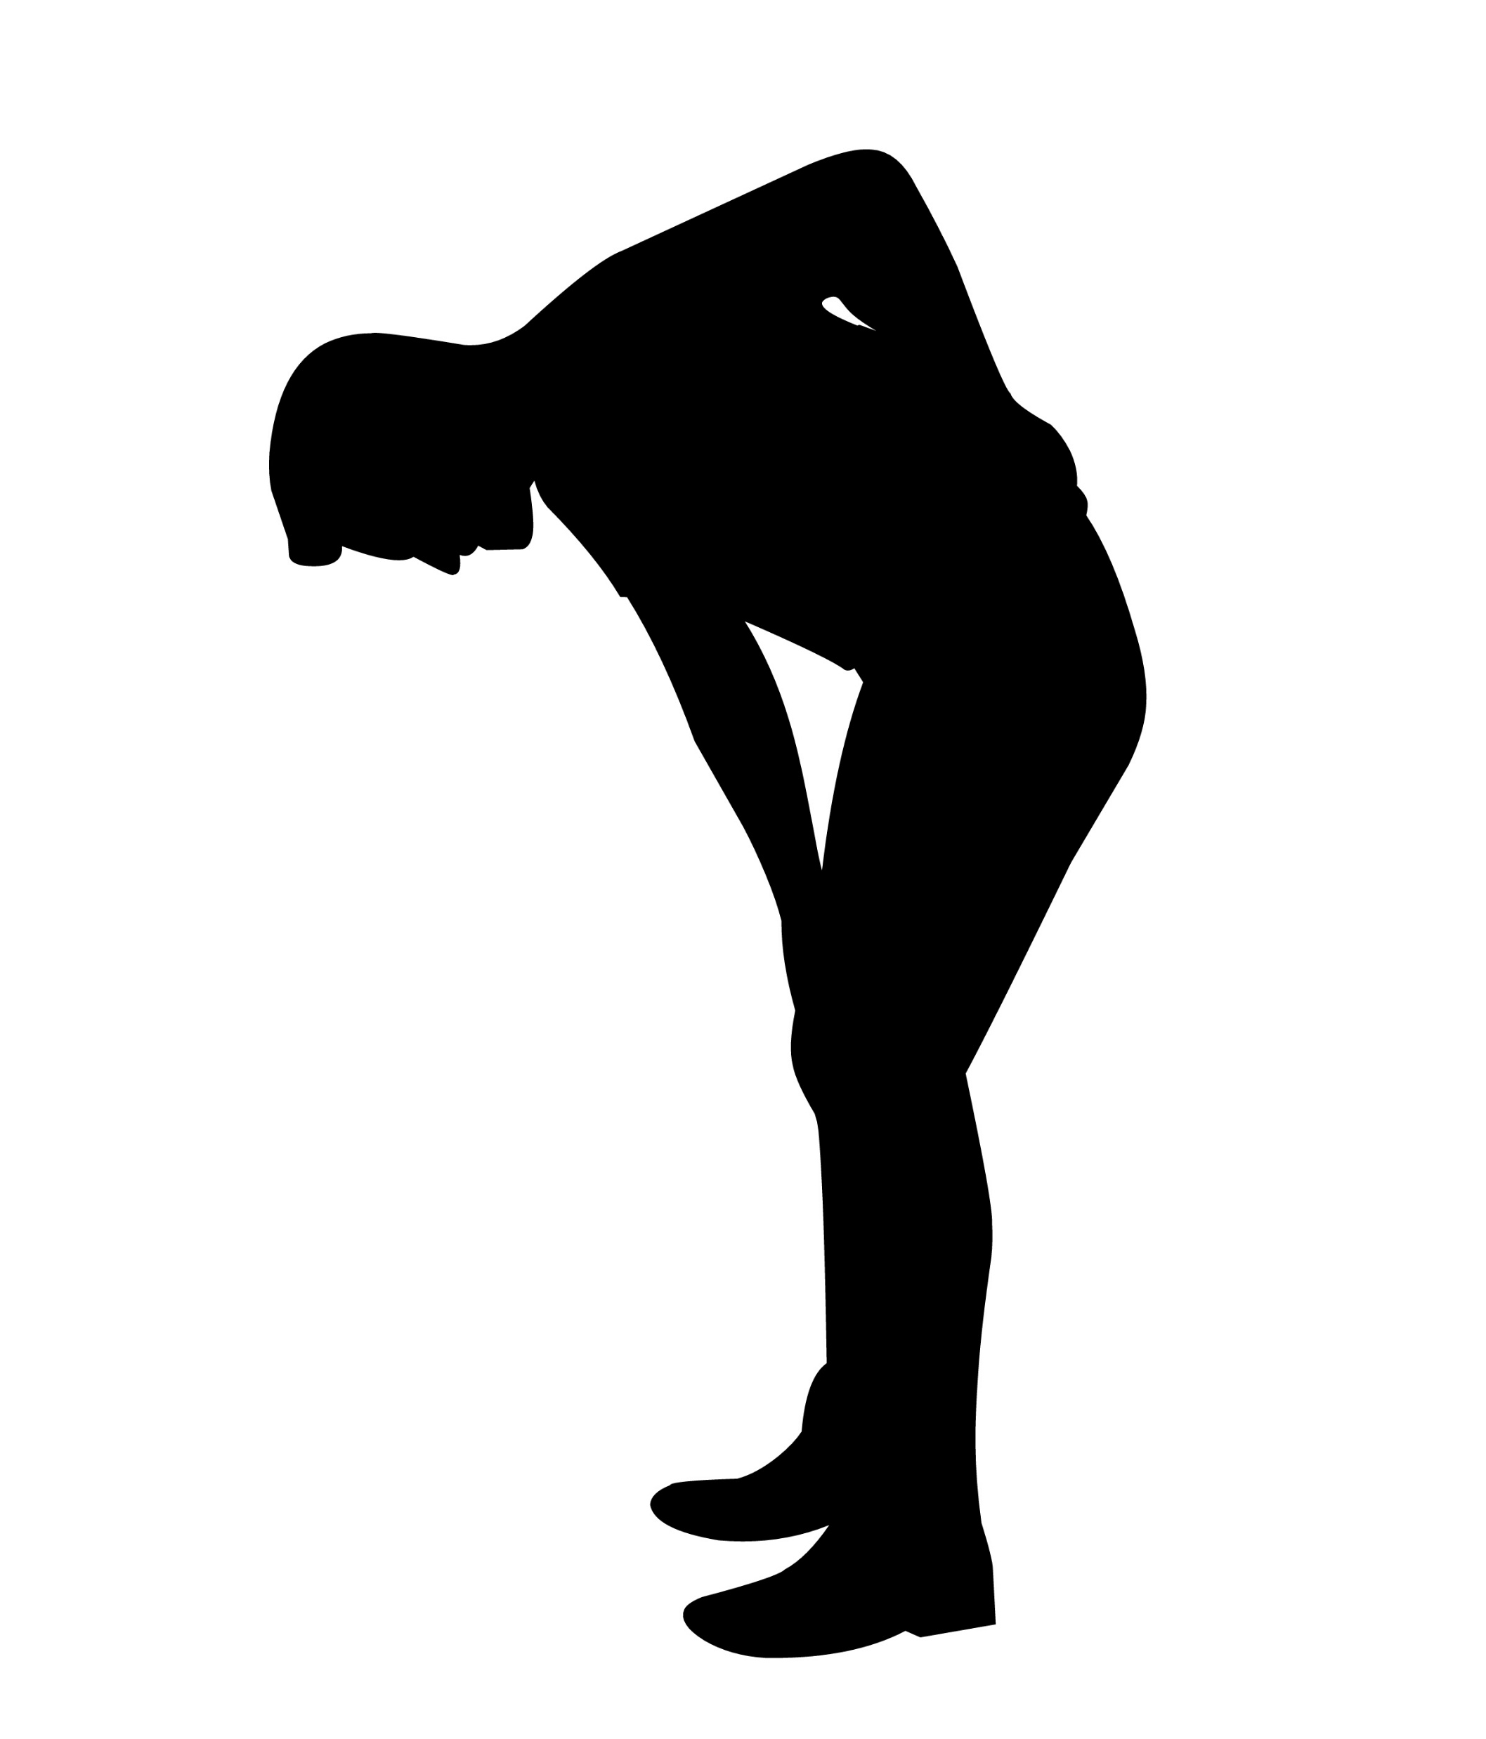
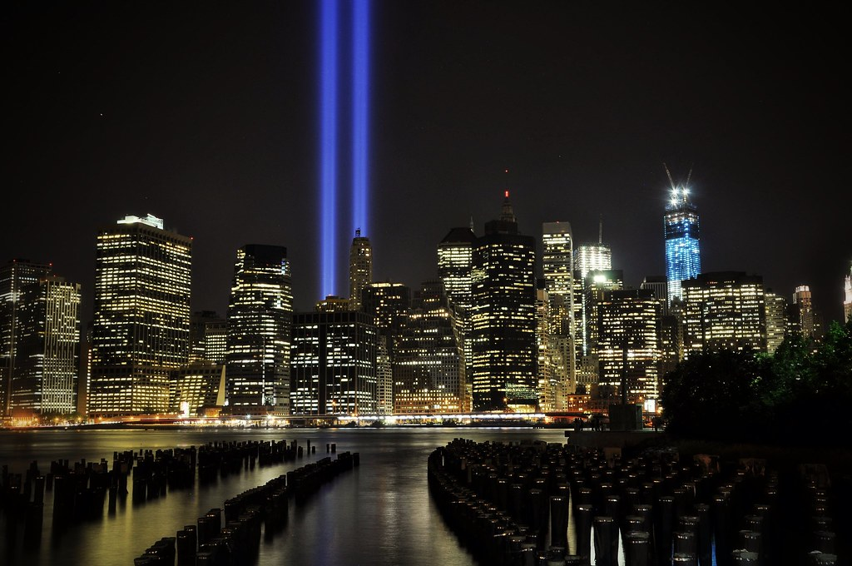
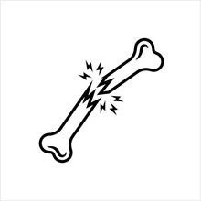


Slide 7
Complex PTSD Symptoms
Flashbacks Memory Lapses
Distorted Sense of Self Emotional Dysregulation
Hyperarousal Unexplained Upset Stomach
Sleep Disturbances Interpersonal Challenges
Avoidance Substance Abuse
Low Self Esteem Chronic Health Conditions
Thoughts of Suicide Unexplained Headaches
Autoimmune Conditions Hypervigilance

Slide 8
BLUE WOUNDS
Absent/ Neglect wounds
“The absence of something that SHOULD have happened.”
Very hard to measure and name because how do you measure what you didn’t get?
Make molehills from mountains; i.e. Grand minimizers
“It didn’t matter! (Because I didn’t matter.)”
Children come into the world with the same basic needs: Shelter, Safety, Love, and need to be prioritized
Results in a Fundamental sense of unworthiness
Notes:
Discuss the developmental stage of egocentricity and how blue wounds impact that.

Slide 9
YELLOW WOUNDS
Enmeshment and Role Confusion
I don’t know where I begin and YOU end.
Present in families with high parental need that supercedes the needs of the children
Children lose their childhoods
Results in lifetime pervasive anxiety
Claudia Black story about parentalized children
Notes:
Share client stories about emotional incest. $ and Sex

Slide 10
WOUND RECAP
RED WOUNDS- The Presence of Something that SHOULD NOT have happened.
Resulting in PTSD symptoms.
BLUE WOUNDS- The Absence of Something that SHOULD have happened.
Resulting in a Fundamental Sense of Unworthiness
YELLOW WOUNDS- Enmeshment and Role Confusion.
Resulting in Pervasive Anxiety

Slide 11
TRAUMA EGG
Also called the Murray Method.
Marilyn Murray, psychotherapist, created model in 1983
Trauma identification and mapping
Assists with insight and shame reduction
My belief, “There is no such thing as unusual behavior when you know the backstory.” AND “ We may never know the full back story.”

Slide 12
TRAUMA EGG
Marilyn Murray- The Murray Method
Perfectionism
People-Pleasing
Codependency
Relationship-Dependency
Sex and Love Addiction
Alcohol Dependency
Image Management
Self-Injury
Control
Manipulation
Intimidation
Dissociation
Minimization
Intellectualization
Survivor Self
ALONE
TERRIFIED
GUILT
HURT
FEAR/SHAME
ENRAGED
ANGRY
ANXIOUS
HOPELESS
Authentic Self/
Healthy Adult
3rd Grade- Mom attempted suicide and I found her
1st grade- Dad left and told me I was now the man of the house
4 years old- Mom went into the hospital. Dad just said she was sick.
True Self
Notes:
True Self

Slide 13
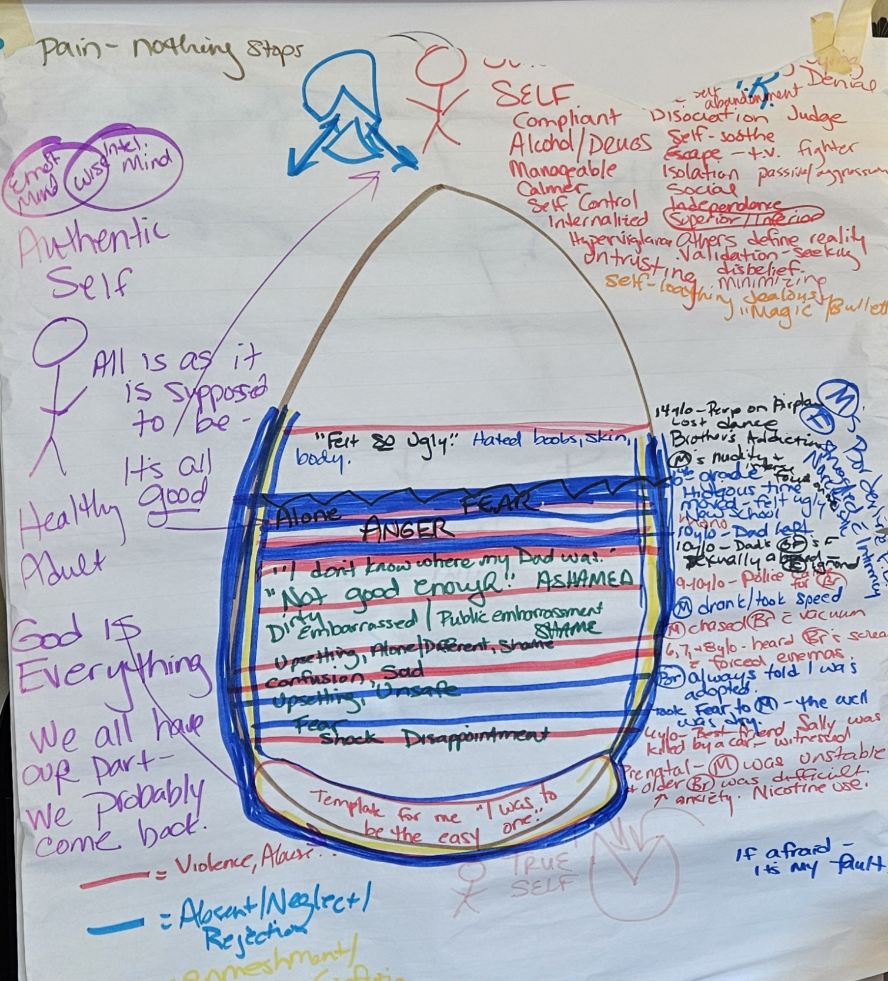

Slide 14
Authentic self
Frozen Feelings
Survivor Skills
Loving
Hopeful
Generous
Compassionate
Playful
Intelligent
Resilient
Determined
Loyal
Adaptable
Grateful
Honest
Faithful
Alone
Terrified
Guilt
Hurt
Enraged
Angry
Anxious
Hopeless
Fear
Shame
Perfectionism
People-pleasing
Codependency
Relationship Dependency
Sex/Love Addiction
Alcohol dependency
Image Management
Self Harm
Control
Manipulation/intimidation
Minimization
Intellectualization
Dissociation

Slide 15
Trauma Egg Assignment Suggestions
1) Document messages received in childhood that have become core beliefs in adulthood.
A. Which beliefs do you wish to hold onto?
B. Which beliefs do you wish to modify?
C. Which beliefs will you surrender because they came from someone else’s wound?
2) Nightly journal:
A. 3x during the day that you reacted from survivor;
B. 3x you acted in authenticity when you were tempted to react from survivor;
C. Which feelings do you identify as the catalyst in each example?

Slide 16

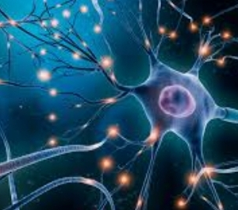




Healing Trauma Through Polyvagal Interventions:
Using What Your Body Already Knows

Slide 17
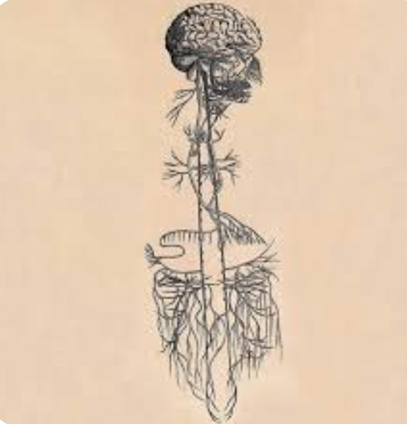
Vagus Nerve

Slide 18
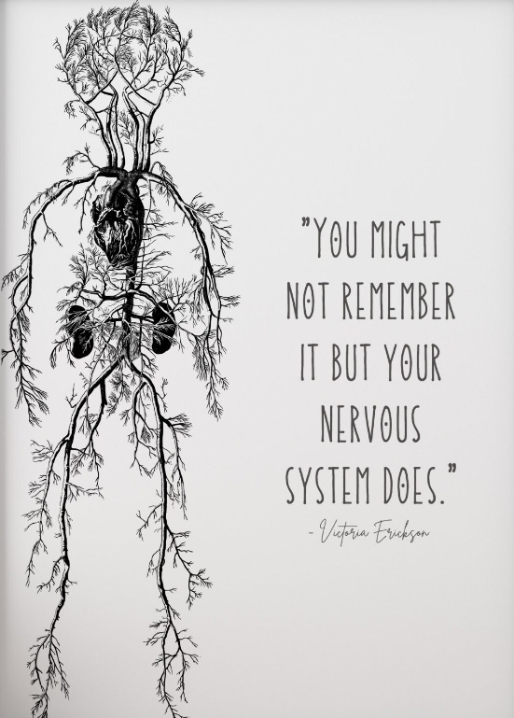

Slide 19
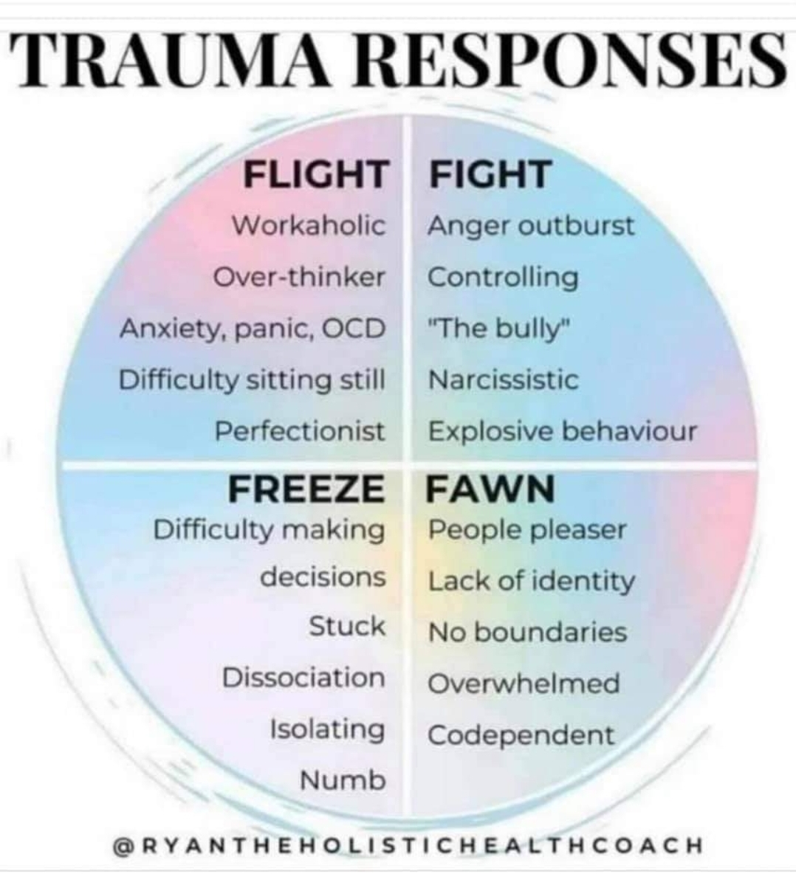

Slide 20
GLIMMERS AND TRIGGERS

Slide 21
TRIGGERS
Triggers activate the sympathetic nervous system, leading to feelings of fear, anxiety, or stress
Triggers are sensory reminders, usually of past trauma, that can cause an intense and unexpected emotional and physiological reaction
Triggers activate the fight, flight, freeze, and fawn responses
Triggers result from an individual’s personal narrative and are highly individualized

Slide 22
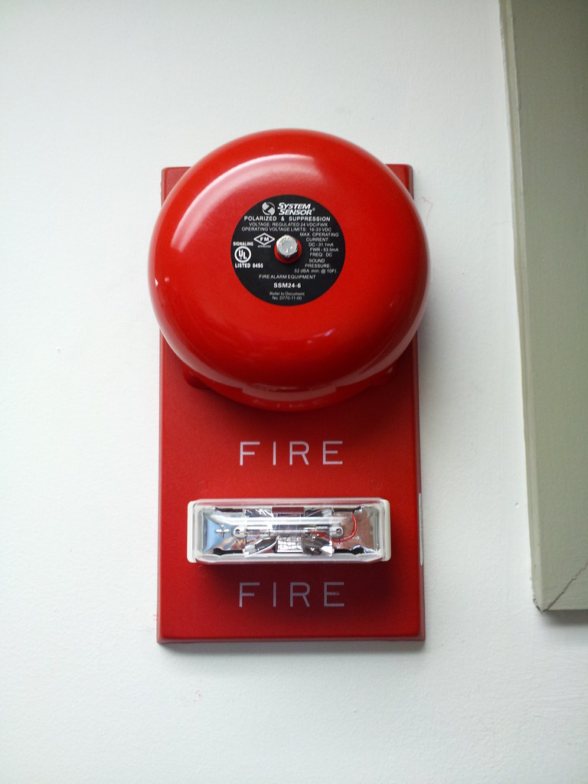

Slide 23
TRIGGERS ARE OUR FRIEND
WHY?
Because they come to us as reminders of wounded places that need our help.
They are powerful parts of ourselves, lost experiences suspended in space and time, longing to be reclaimed and embodied.
JAN WINHALL 2024

Slide 24
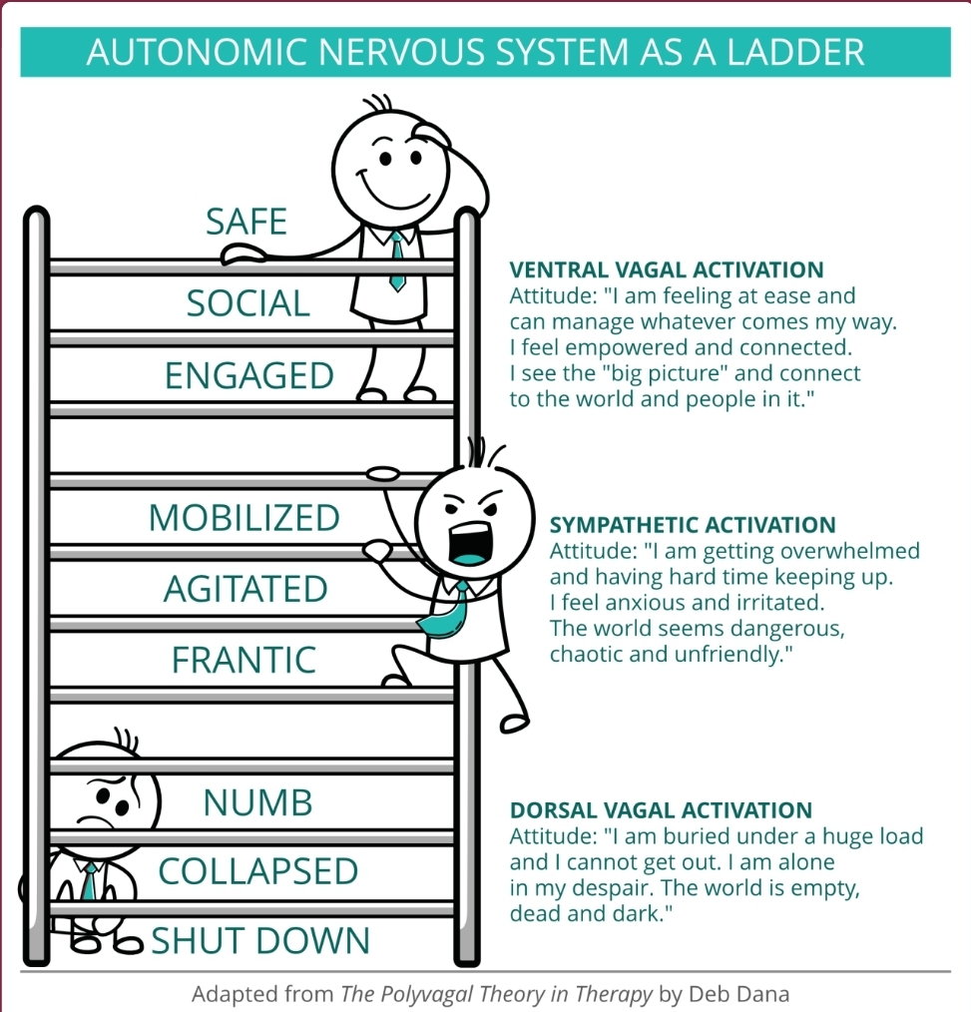
Notes:
Spend time on each section of the ladder. Sympathetic activation and its impact on inner ear muscles high and low frequency attunement and neutral face interpretation from sympathetic.
Dorsal Vagal- shut down. Cant hear, sometimes cant see. Dissociation is the ultimate freeze
Ventral Vagal- Hawaii- able to coregulate and focus on human voice and nonverbal cues. Freed up for connection that feels safe and rewarding

Slide 25
GLIMMERS
Glimmers are Small subtle moments that cue our nervous system to feel safe, calm, and connected, prompting a sense of well-being and regulation.
They are not necessarily grand or life-altering experiences, but rather small, everyday moments that can have a positive impact on our nervous system.
DEB DANA

Slide 26
EXAMPLES OF GLIMMERS
SEEING A FRIENDLY FACE
HEARING A SOOTHING SOUND
NOTICING SOMETHING IN THE ENVIRONMENT THAT BRINGS A SMILE
FEELING A TINY CHANGE IN YOUR BODY
NOTICING A THOUGHT THAT HOLDS A HINT OF HOPE
SMELLING LAVENDER OR SOME OTHER RELAXING SCENT
PETTING A DOG OR CAT
BEING IN NATURE
A STRANGER SMILING AT YOU IN PUBLIC
THE PERFECT CUP OF COFFEE OR TEA
DEB DANA

Slide 27
EXERCISES FOR VAGAL TONING

Slide 28
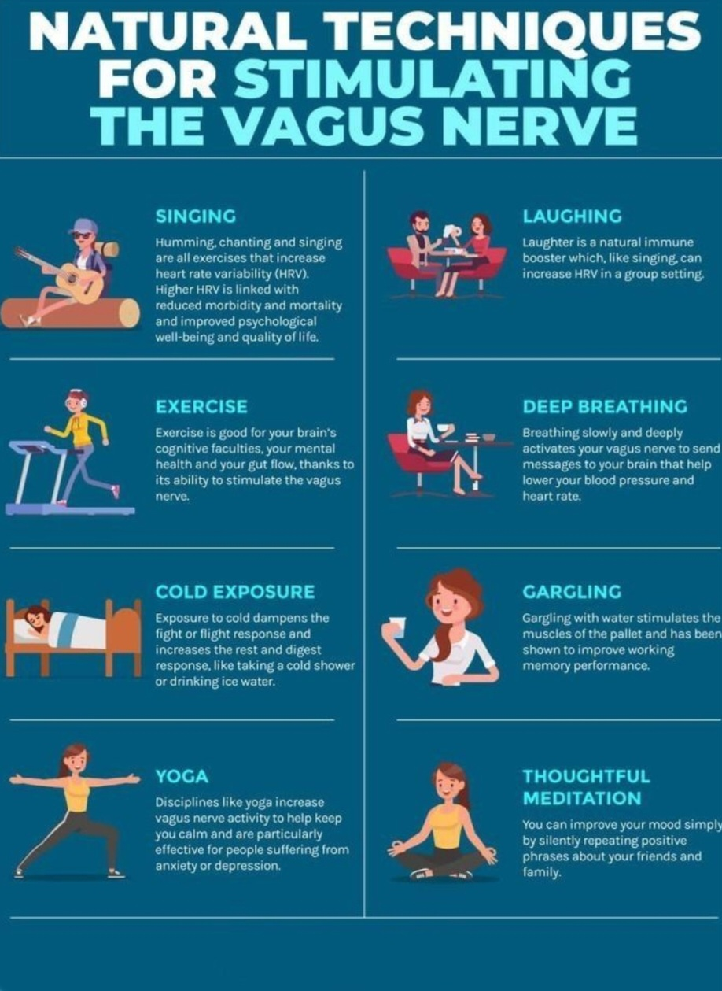

Slide 29
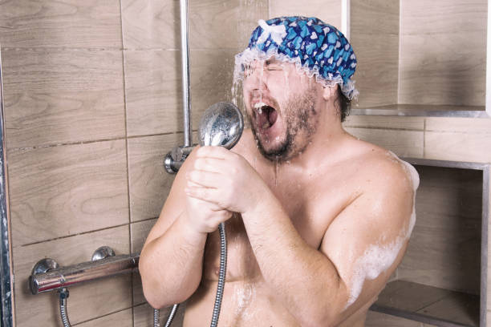
SINGING

Slide 30
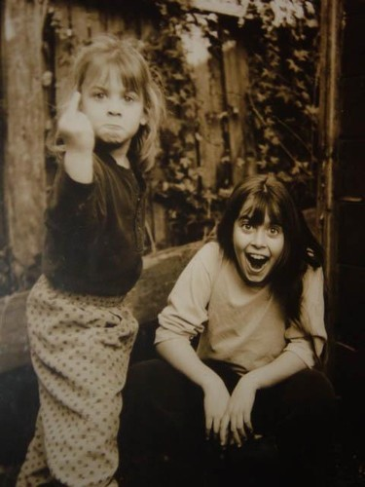

LAUGHTER

Slide 31

BILATERAL MOVEMENT

Slide 32
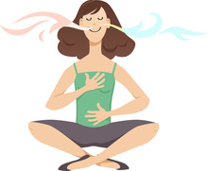
DEEP AND MINDFUL BREATHING

Slide 33
BOX BREATHING
Hold
In
Out
Hold

Slide 34
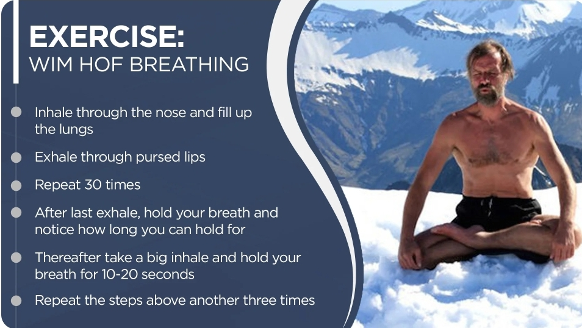
Wim Hof Breathing

Slide 35
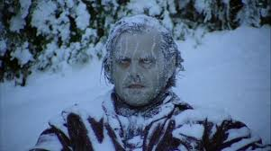
COLD EXPOSURE

Slide 36
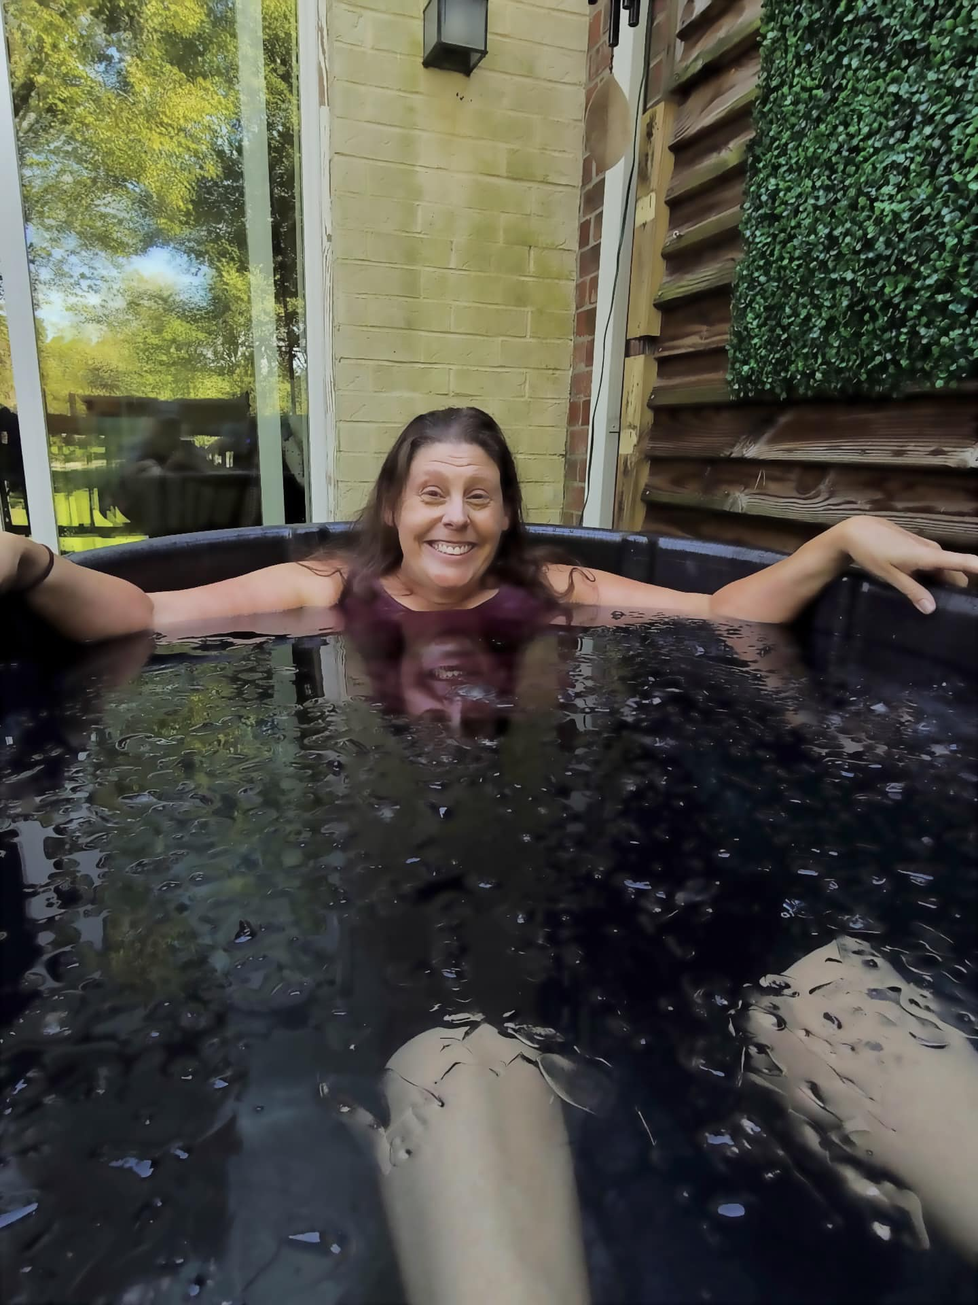
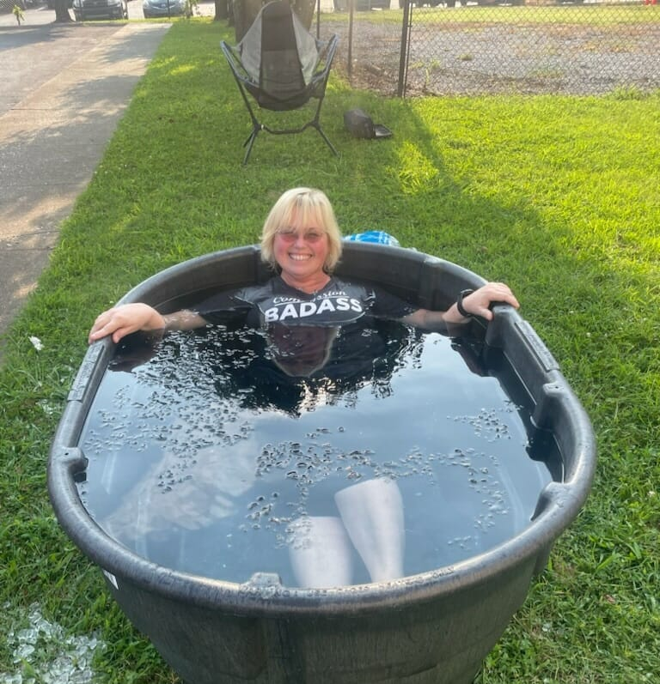
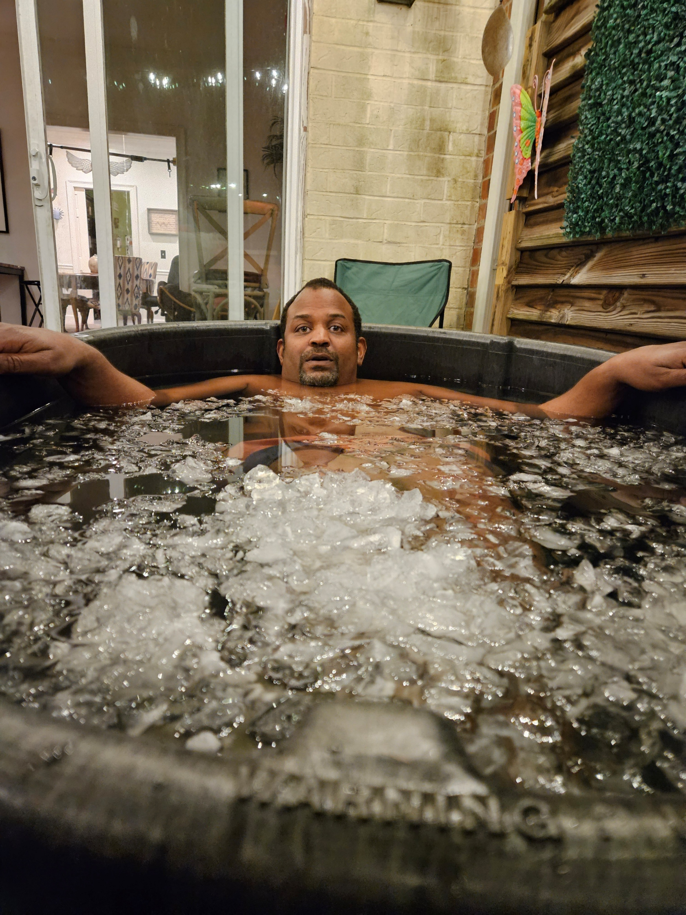
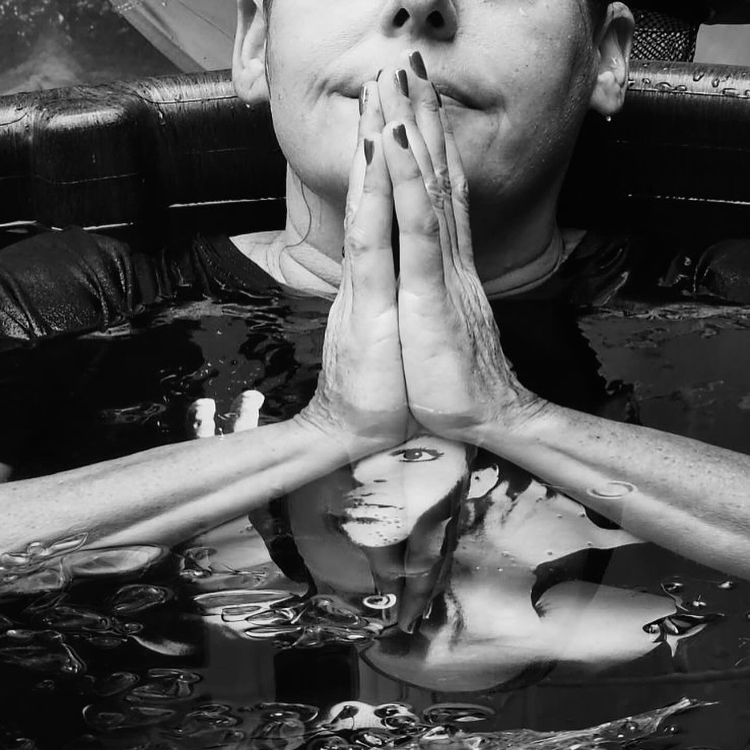
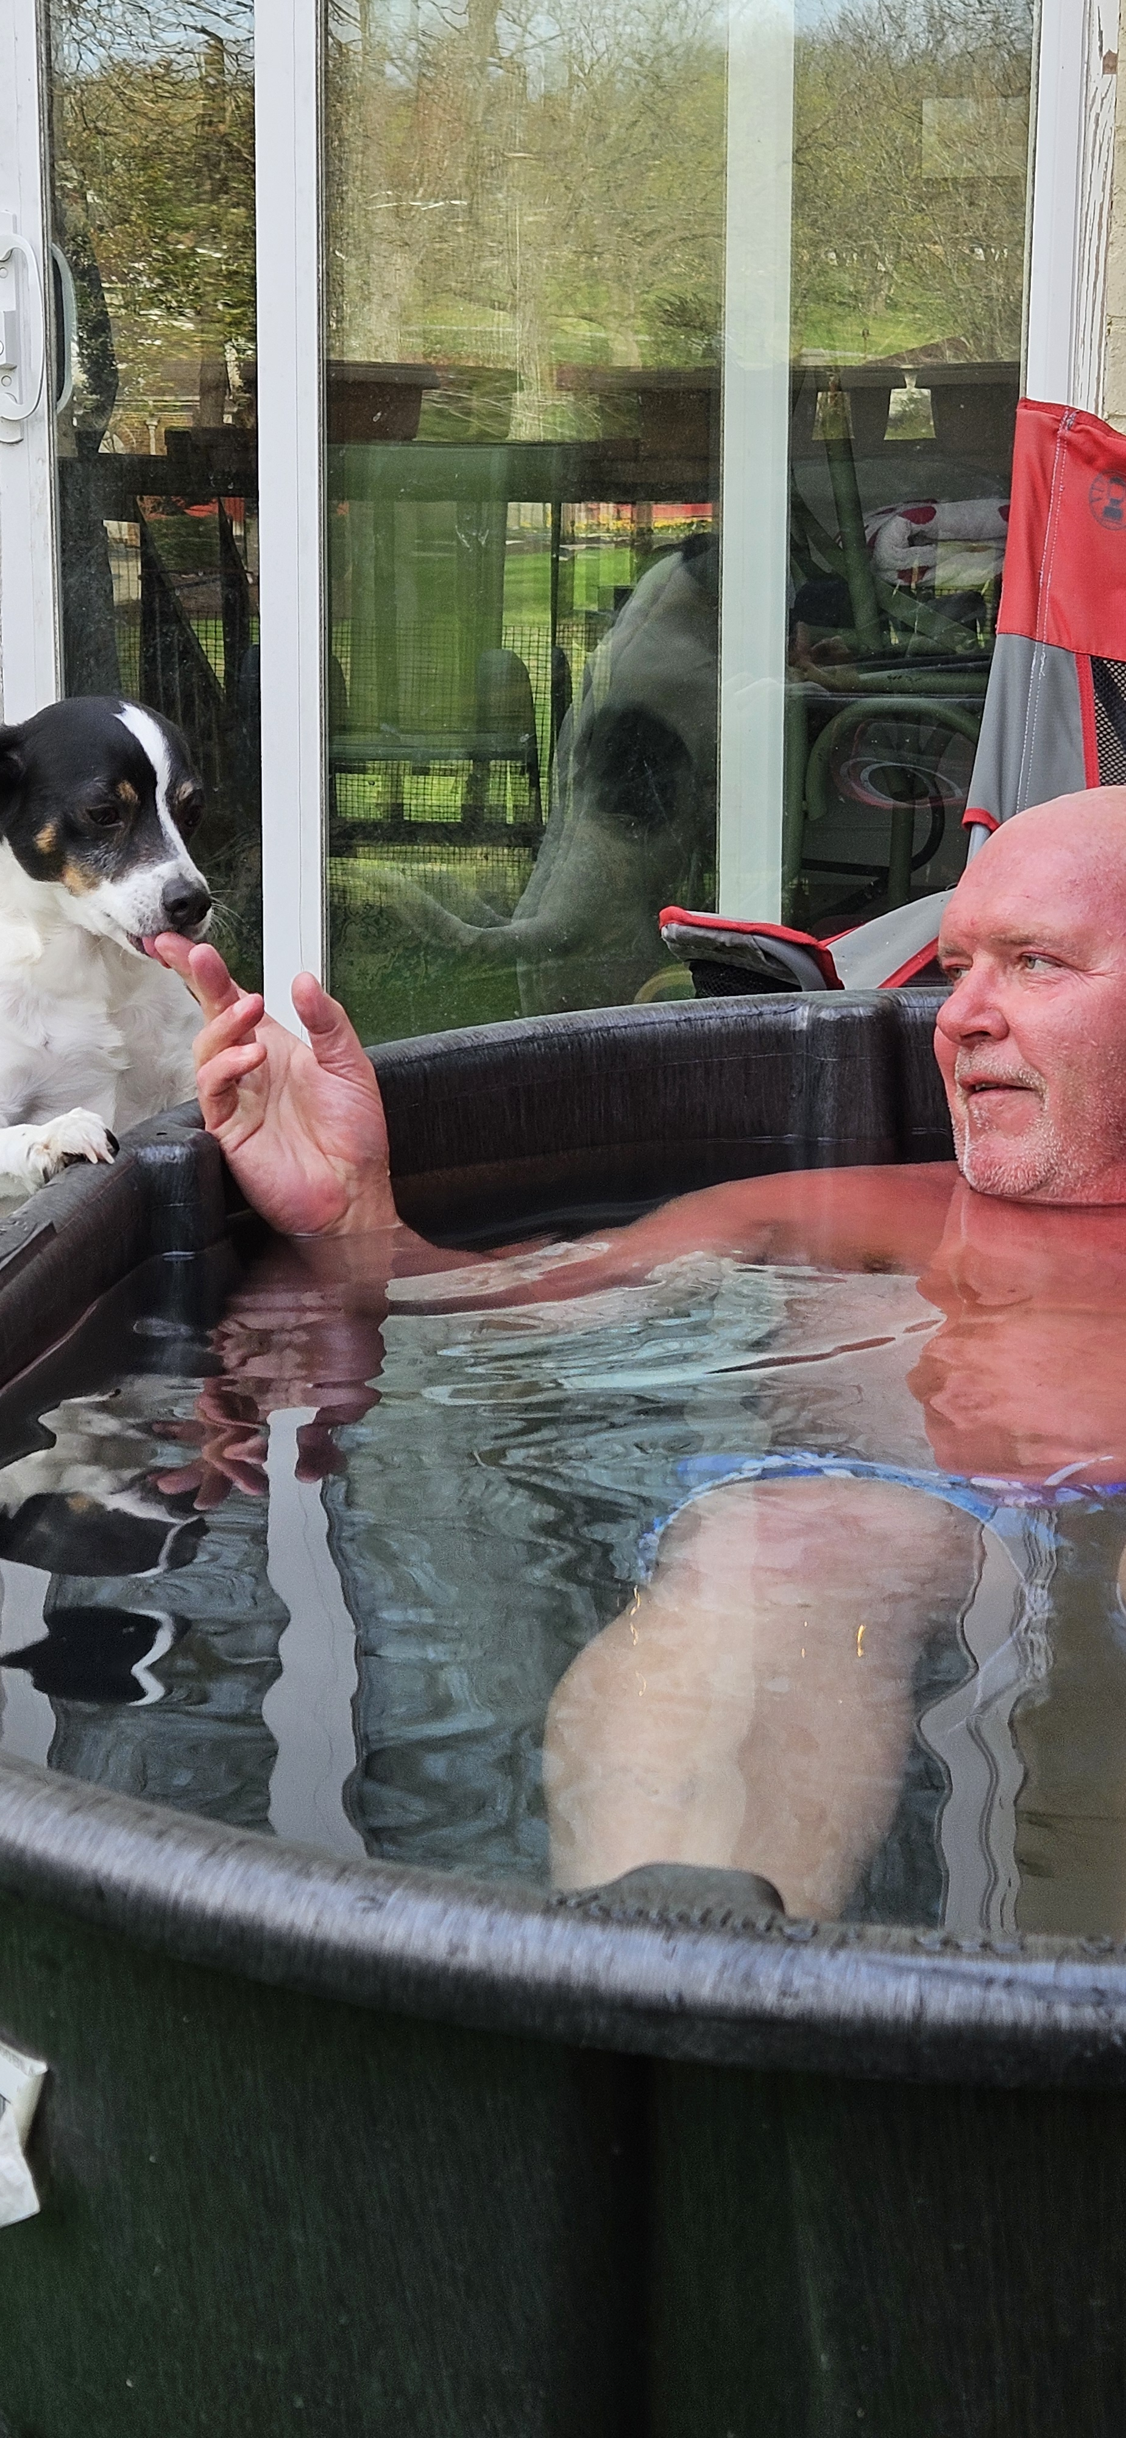
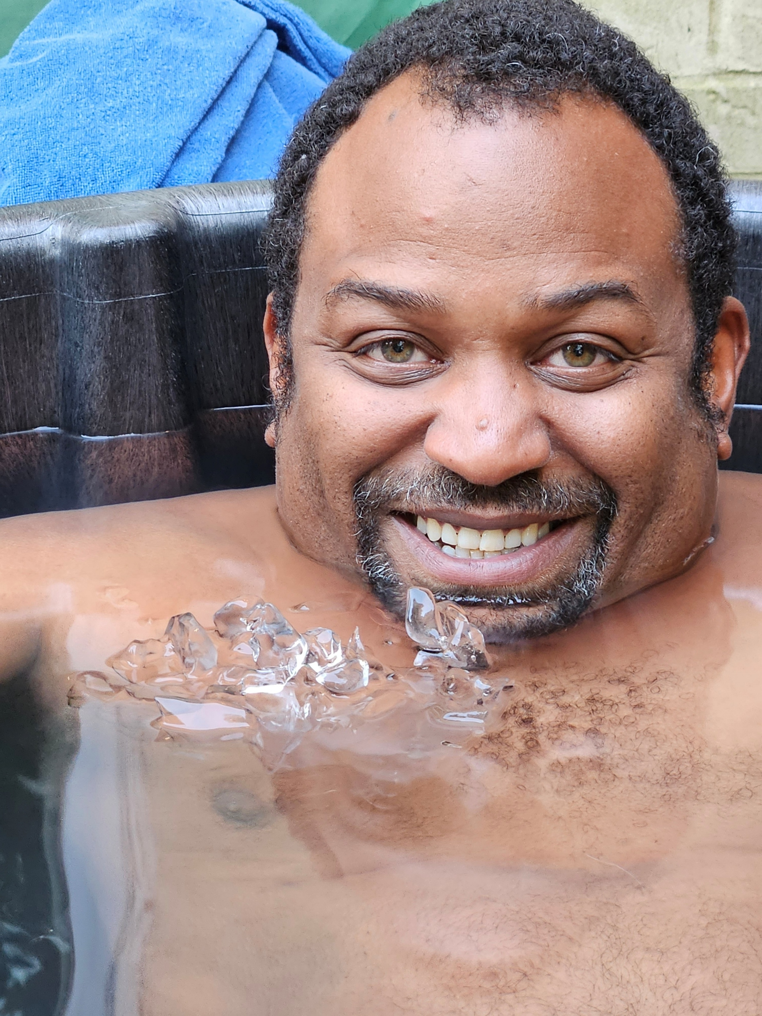
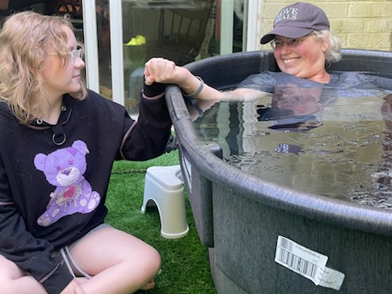

Slide 37

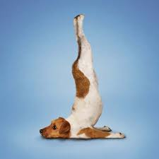
YOGA

Slide 38

MEDITATION

Slide 39
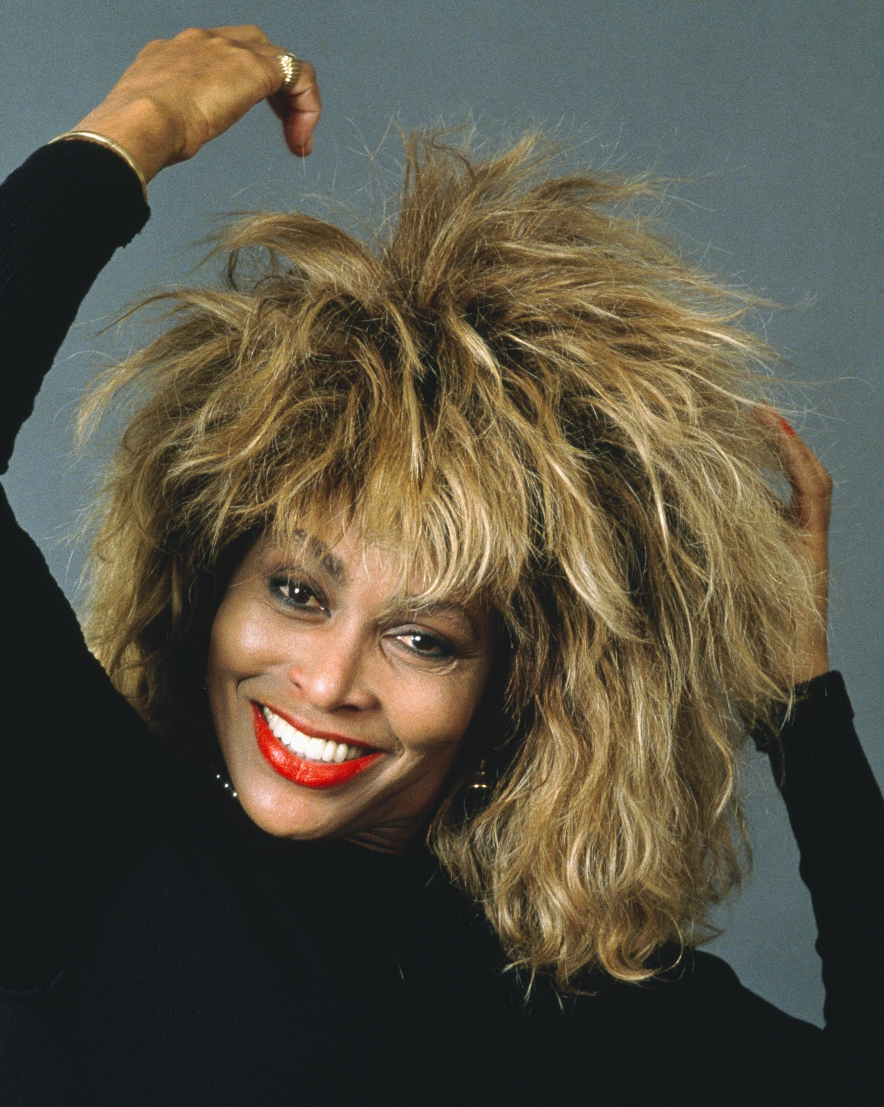
CHANTING, HUMMING, CONTEMPLATIVE PRAYER
This Photo by Unknown Author is licensed under CC BY-SA-NC

Slide 40
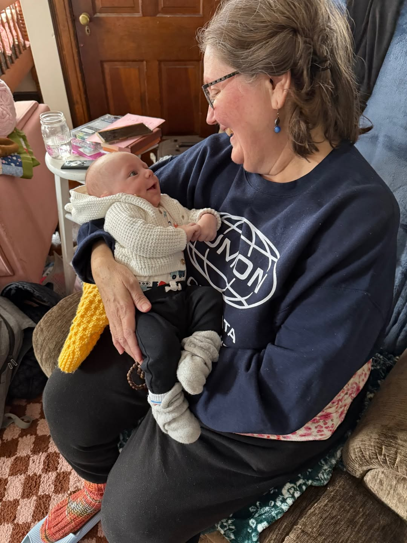
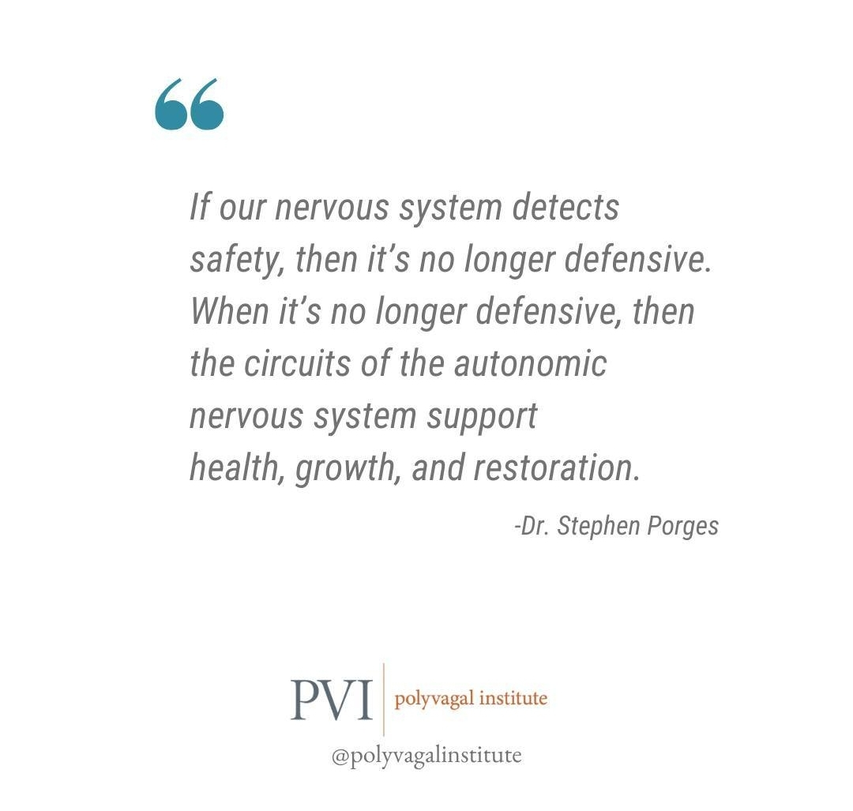
COREGULATION

Slide 41
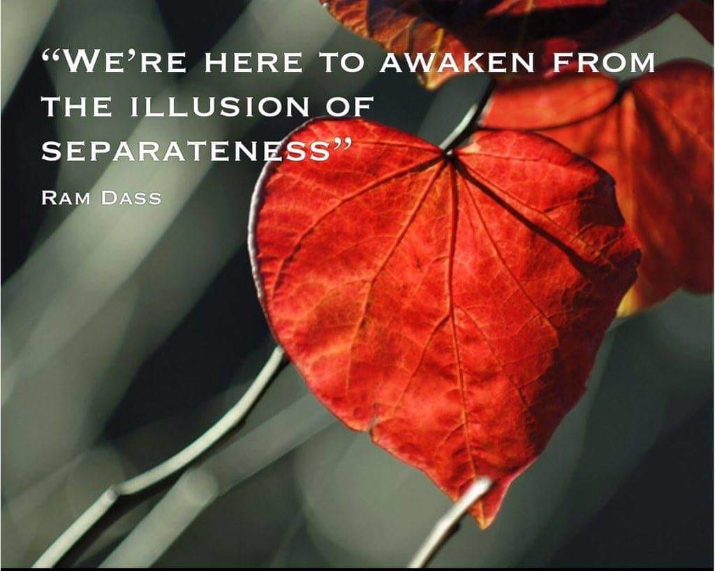

Slide 42
Resources:
  The Polyvagal Theory
  Stephen W. Porges
  The Polyvagal Theory In Therapy
  Deb Dana
  Anchored
  Deb Dana and Stephen Porges
  The Myth of Normal
    Dr. Gabor Mate’ and Daniel Mate’
  The Anxious Generation
  Jonathan Haidt
  The Sum of Us: What racism costs Everyone and how we can prosper together
    Heather McGhee
  In The Realm of Hungry Ghosts: Close encounters with addiction
    Dr. Gabor Mate
  The Body Keeps The Score: Brain, mind, body in the healing of trauma
    Bessel Van Der Kolk, MD

Slide 43
Resources:
  The Wim Hof Method
  Wim Hof and Elissa Epel, PhD
  Radical Acceptance
  Tara Brach
  Healing Trauma and Addiction With the Felt Sense Polyvagal Model- A Bottom-Up Approach
  Jan Winhall
  20 Embodied Practices for Healing Trauma and Addiction Using The Felt Sense Polyvagal Model
  Jan Winhall
  The Pain Antedote
  Mel Pohl, MD and Katherine Ketcham
  Pain Recovery- How To Find Balance and Reduce Suffering From Chronic Pain A Comprehensive Opioid-Free Approach
  Mel Pohl, MD, Frank J. Szabo, Jr, LADC, Daniel Shiode, PhD, and Robert Hunter, PhD
  A Day Without Pain
  Mel Pohl, MD

Slide 44

